Slide 1
How is your club doing?

Slide 2
Agenda
Rotary International Goals
RI Membership
Successful Clubs
RC of Your Club Name Here
RI Resources

Slide 3
RI Strategic Goals

Slide 4
REGION | PORTION OF ROTARY CLUB MEMBERS | CHANGE SINCE 2011
Asia | 34% | +26%
U.S., Canada, & Caribbean | 27% | −20%
Europe, Africa, & the Middle East | 25% | −3%
Latin America | 8% | −8%
Great Britain & Ireland (RIBI) | 3% | −30%
Australia, New Zealand, & the Pacific Islands | 3% | −25%
Notes:
And this is membership by region as of 1 July 2021. Asia now has 34% of our total membership, followed by the United States, Canada, and the Caribbean at 27%.
In Asia, membership has grown by 26% in the last 10 years, while it has declined by 30% in Great Britain/Ireland, and by 25% in Australia, New Zealand, and the Pacific Islands.

Slide 5
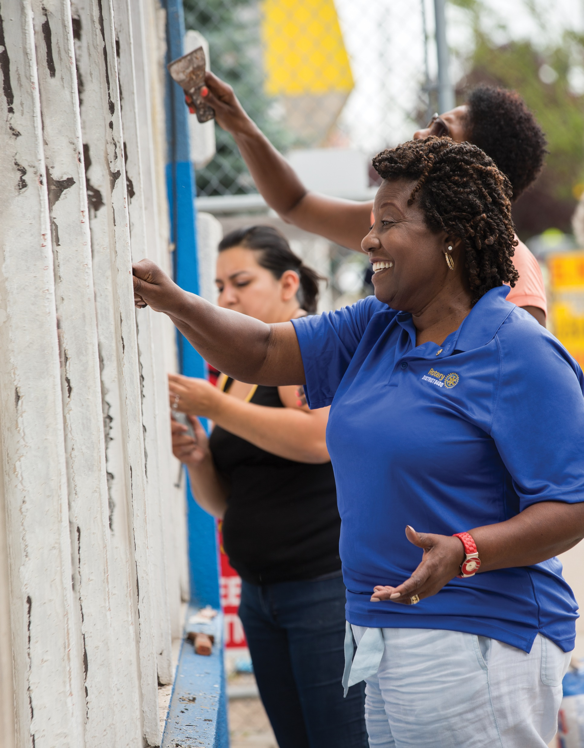
ROTARY CLUB Member
gains & losses, 2020-21
+138,000
New & readmitted members
Terminated members
−150,000
13,000 left Rotary in their first year
Notes:
We also know that continuing to meet our members’ expectations is both a challenge and an opportunity. We can’t add members to clubs while overlooking the importance of offering everyone an engaging experience. Last Rotary year, we welcomed nearly 121,000 new members into our Rotary clubs and welcomed back 17,000 former members. But approximately 13,000 of all of new members members terminated their membership within their first year. Generally, about 10% of all new members leave Rotary within a year. And more than 137,000 continuing Rotarians also left last year.
Let’s look at why people want to join Rotary and Rotaract in the first place.

Slide 6
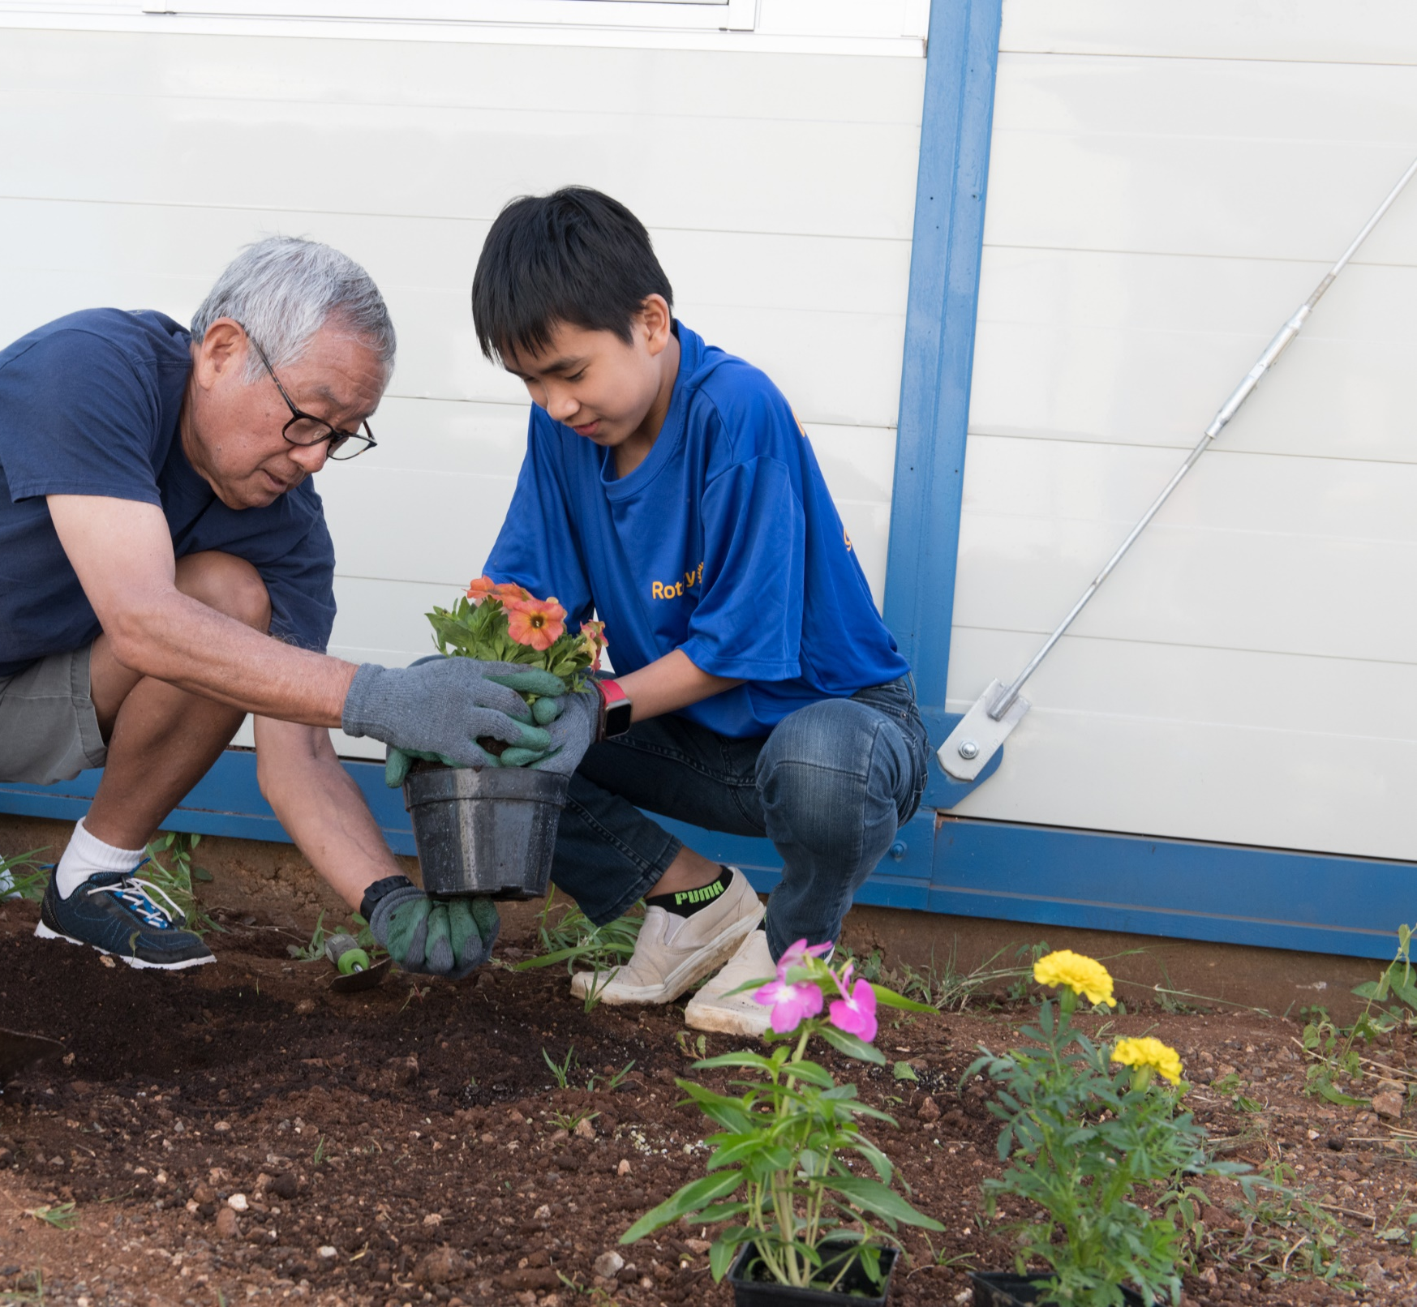
WHAT MEMBERS WANT
Local community service
Connecting with others
Professional & leadership development opportunities
Notes:
Rotarians and Rotaractors have slightly different priorities in their reasons for joining and staying, but generally, they are looking for three things: Local service, connecting with others, and professional and leadership development opportunities.
When we ask former members why they left, many cite “unmet expectations.” It’s important to remember this, especially when many clubs are working hard to keep members involved in the midst of a pandemic. 30% of current members say they aren’t satisfied with their club experience.
Through these surveys, we have also discovered a compelling connection between member satisfaction and member retention.

Slide 7
FACTORS THAT INFLUENCE MEMBER SATISFACTION:
Comfort with other club members
Club’s positive impact in the community
Confidence in club leadership
Enjoying club meetings
FACTORS THAT INFLUENCE MEMBER RETENTION:
1. Comfort with other club members
2. Enjoying club meetings
Notes:
Feeling welcomed by and comfortable with other club members is the single most important variable when it comes to both member satisfaction and member retention. As comfort increased, the probability of having a higher satisfaction with membership increased as well.
In fact, a member who is not at all comfortable with other members is two to four times more likely to terminate their membership than a member who is extremely comfortable.
This applies not just to current club members, but to anyone and everyone who engages with Rotary. No matter who they are, where they are in the world, or how long they have been connected with us — all members, prospective members, and other participants, deserve and expect to feel valued, respected, and welcomed

Slide 8
Successful Clubs
Have a welcoming, engaging presence and meetings
Notes:
https://youtu.be/aSA3FqVufbQ

Slide 9
Notes:
https://youtu.be/aSA3FqVufbQ

Slide 10
Successful Clubs
Have a unique club identity

Slide 11
Successful Clubs
Have a unique club identity
Engage their members

Slide 12
Successful Clubs
Have a unique club identity
Engage their members
Have a robust, member-driven service program

Slide 13
Successful Clubs
Have a unique club identity
Engage their members
Have a robust, member-driven service program
Meet members’ desire to socialize with others

Slide 14
Successful Clubs
Have a unique club identity
Engage their members
Have a robust, member-driven service program
Meet members’ desire to social with others
Provide strong leadership

Slide 15
Successful Clubs
Have a unique club identity
Engage their members
Have a robust, member-driven service program
Meet members’ desire to social with others
Provide strong leadership
Review their club’s health

Slide 16
Your Club Membership Data Here
Club | 1-Jul-18 | 1-Jul-19 | 1-Jul-20 | 1-Jul-21 | 1-Jul-22 | MGI
club | 33 | 33 | 37 | 34 | 37 | 12

Slide 17
Your Club Membership Data Here
District ID: 5160 | Existing Members | New Members
Club ID | Club Name | # of Members @ : 1 July 2019 | Terminated | Readmitted | Retention Percentage | Admitted | Terminated | Readmitted | Retention Percentage | # of Members @ : 30 June 2022
# |  | 33 | (4) | 0 | 87.88% | 8 | 0 | 0 | 100.00% | 37
Notes:
2022-23 goal: 40

Slide 18
How Does Your Club Rate?
Jigsaw: Rotary Club Health Check
Your Club Experience
Service & Socials
Members
Image
Business and Operation

Slide 19
Your Club Experience
Our club meetings are relevant, interesting and varied.
Our meetings are organized and are run professionally.
Members make an effort to meet and talk with different people at each meeting.
Our club tries new things (activities, meeting practices and formats, service, socials, etc.) to enrich members’ experience.
We recognize members’ service, engagement, and donations by nominating them for and presenting them with awards.

Slide 20
Service & Socials
Our club holds regular get-togethers (in addition to club meetings) for socializing and networking.
Our club encourages members to bring partners, spouses, friends, and family members to club meetings and events.
We consult community leaders and community members to determine needs before choosing a project
All members can give input, such as their vocational expertise, on service and social activities.
Our club has a Rotary Foundation committee chair and a service projects committee chair.

Slide 21
Members
Our club represents the racial or ethnic diversity of our community.
Our club seeks to attract members from professions in the community that are underrepresented in the club.
At least 75% of our club members are involved in a hands-on service project, a leadership role, or other assigned roles.
Newer and seasoned members are paired for mentoring relationships.
Our club has a membership committee whose chair and members are dedicated to attracting and engaging club members.

Slide 22
Image
We have a public-facing, visually appealing club website that explains what the club does, who its members are, and the benefits of membership.
We have social media accounts that show our followers the difference we make in our community.
Our club appeared in the local media several times last year.
The club brochure we give to community members and prospects shows the impact we make.
Our club has a public image committee whose chair and members are dedicated to public image and outreach

Slide 23
Business & Operations
Our club has a strategic plan that we update regularly.
Our club board meets at least quarterly to review our strategic plan, measure our progress toward goals, and adjust bylaws and other documents as needed.
Our club board changes what isn’t working well and updates club bylaws accordingly.
We have a process for ensuring continuity that includes identifying future club leaders and preparing them for leadership positions, documenting procedures, and involving current, past, and future leaders in decisions.
Our club has a club administration committee and chair.

Slide 24
Rotary International Resources
My.rotary.org
Learning & Reference
Membership
https://my.rotary.org/en/learning-reference/learn-topic/membership
Notes:
https://urldefense.proofpoint.com/v2/url?u=https-3A__msgfocus.rotary.org_c_1Lszd1bwICPEJmkZAvoXkRuvZT9o&d=DwMFaQ&c=euGZstcaTDllvimEN8b7jXrwqOf-v5A_CdpgnVfiiMM&r=S2eVAxmX_hRHkPpjkiaWj85VjAqbvVvB7xiIqBuSLaU&m=HLcT9np5bTr4TRevotgaXsB-b9RV_bDXfe2iG_buPDg&s=N_vLqVTl__1TMBHs96We719LK_TEA6qUCsQIJUV1jms&e=

