Slide 1
Membership: Best Practices Date Club

Slide 2
Agenda
Individual Rotarian
Club
Process
Team
Data
Activity

Slide 3
Individual Rotarians
Promote

Slide 4
Individual Rotarians
Promote
Invite
Notes:
Invite others (family, friends, colleagues, etc.) t meetings, fund raisers, service projects

Slide 5
Individual Rotarians
Promote
Invite
Participate

Slide 6
Individual Rotarians
Promote
Invite
Participate
Welcome

Slide 8
Member process
RI/Club Logo/Info
Notes:
Develop a process for recruiting, inducting and engaging members.

Slide 9
Member process
Membership Team
RI/Club Logo/Info

Slide 10
Notes:
Membership Chair. Recruit Membership Team members. Why a team? Engage members, many hands make light work, educate. Create Membership Team assignments/roles. Example

Slide 11
Example
Three Teams that focus on the main segments of Membership. Membership Team members will wear specific Membership Team badges (in addition to their regular one).
Building Team leader:
On Boarding Team Leader:
Sustaining Team Leader:

Slide 12
Building I
Greet
Tell
Answer
Follow up
Notes:
Greet prospective members
Tell the Service Above Self story
Answer questions about who we are, what we do
Follow up with visitors

Slide 13
Building II
Coach
Member balance
Fireside Chat
Work with Club Administration and Public Relations
Notes:
Coach sponsors on protocol
Member balance (recruiting initiatives)
Fireside Chat goals and outcomes (invite a “random” member)
Work with Club Administration and Public Relations for recruitment efforts
Website
Facebook
Media

Slide 14
On Boarding I
Align
Paul Harris commitment
Talents, interests
Notes:
Align each new Red Badge member with a mentor
Reinforce Paul Harris commitment up front
Tap into talents, interests

Slide 15
On Boarding II
Red to Blue
Notes:
Red to Blue – check in with Red badgers on progress
Help complete Blue badge requirements in 90 days or less

Slide 16
Sustaining I
Passion
Mentors
Recognition program
Notes:
Keep the passion alive
Select and train mentors
Work with On Boarding to assign mentor to each new Red Badge
Assign mentors to certain Blue badge members who have less than two years tenure

Slide 17
Sustaining II
100% Paul Harris Sustaining
“Disinterested” members
Alumni
Retention efforts
Notes:
Establish and maintain recognition program
Goal: 100% Paul Harris Sustaining - what does it take? ($100/year)
Reach out to members who seem “disinterested”
Check in with alumni for recommendations
Lead all retention efforts

Slide 18
Member process
Membership Team
Meetings
RI/Club information
Notes:
Welcoming: greeters; move around

Slide 19
Member process
Membership Team
Meetings
Inductions
RI/Club information

Slide 21
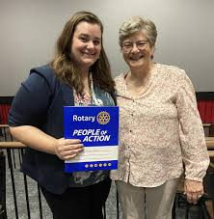
Induction

Slide 22
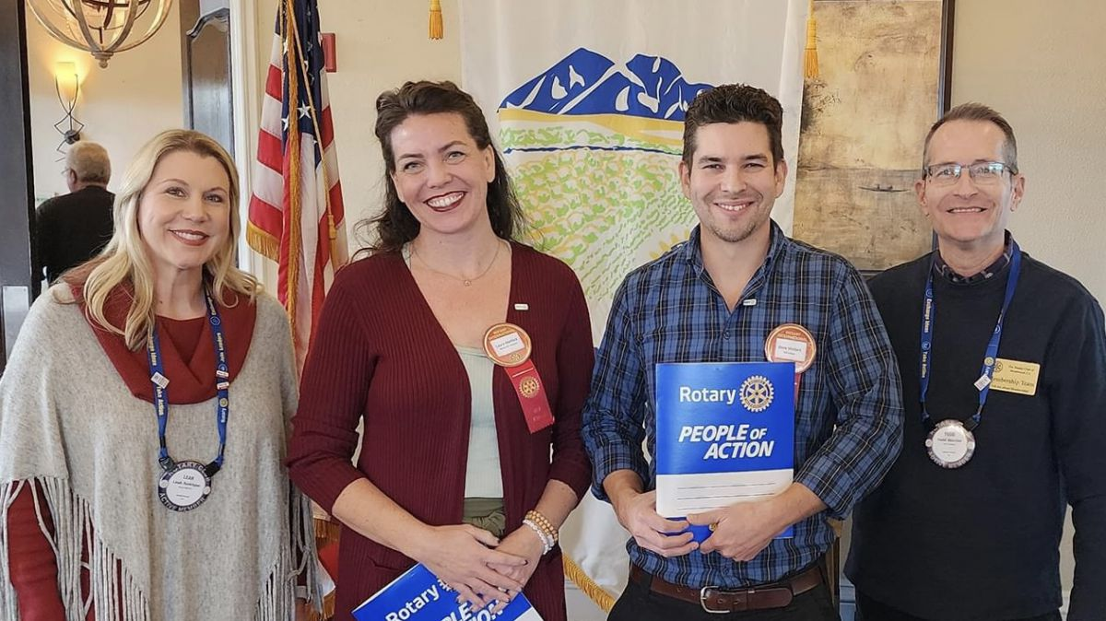
New Members
Club flag/banner
Engage/welcome
Notes:
Orientation session(s),

Slide 23
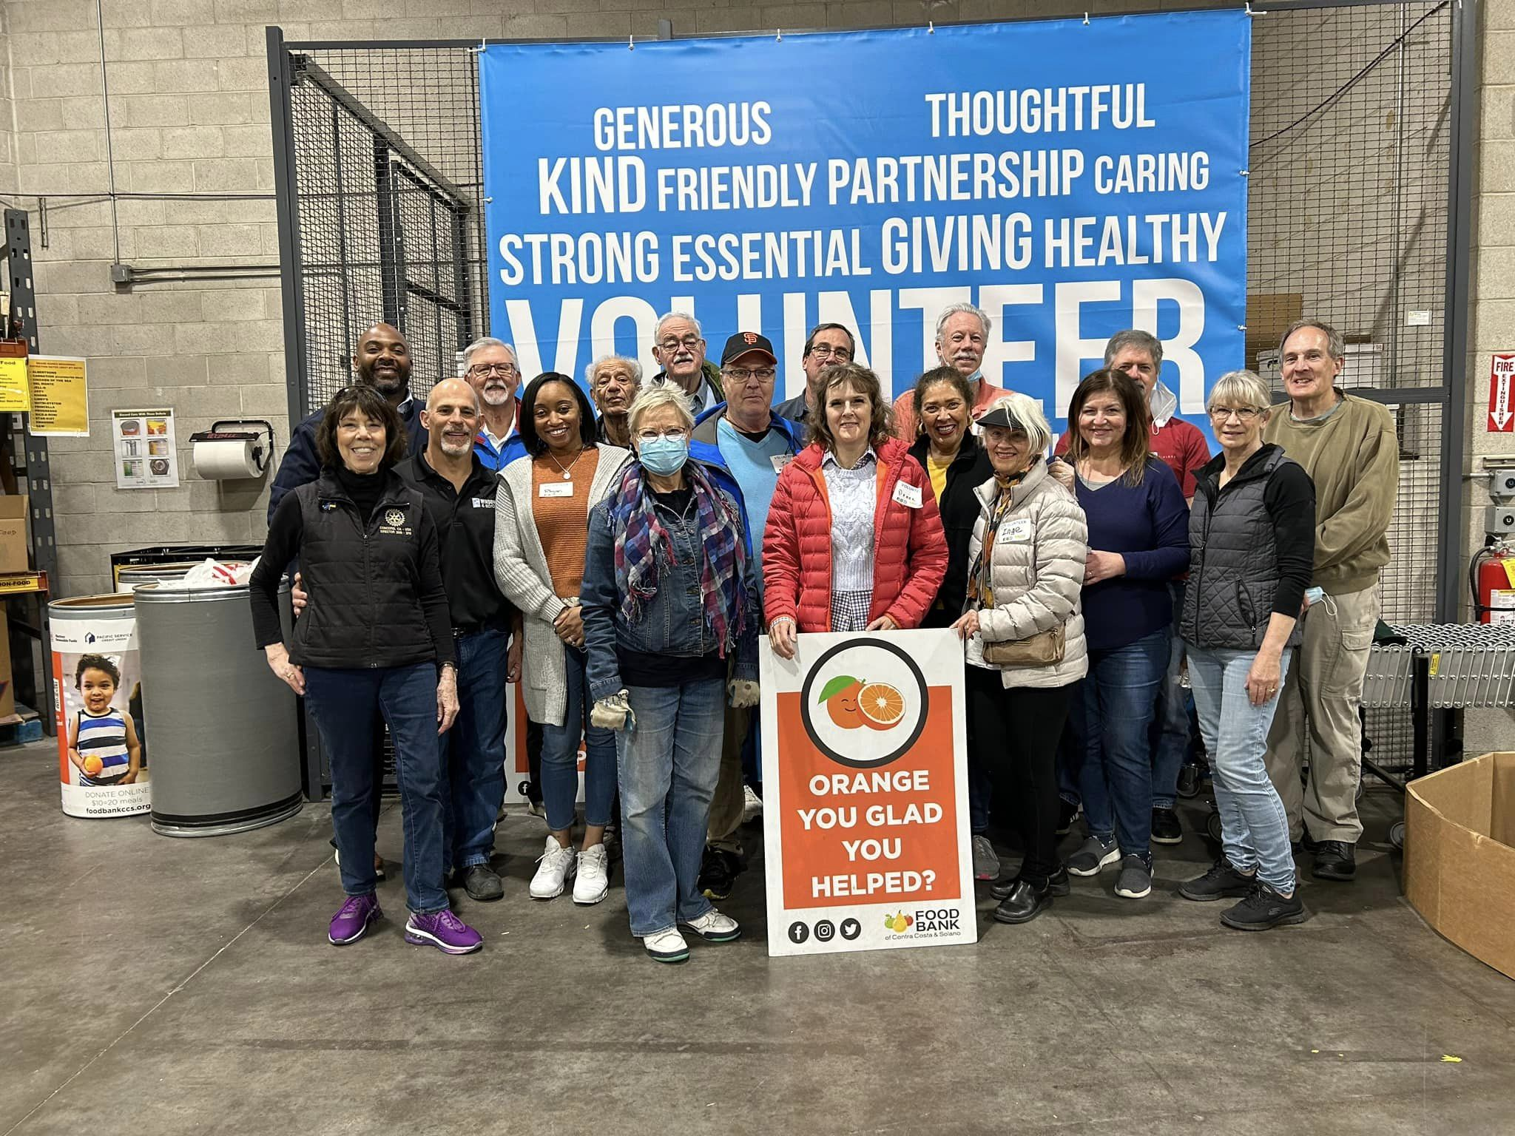
New Members
Club flag/banner
Engage/welcome
Interests
Notes:
Invite to present on their business: Classification talk or Brentwood means Business. Check in to see if have any specific interests. Red to Blue celebration.

Slide 24
New Members
Club flag/banner
Engage/welcome
Interests
Mentor
Notes:
A 2002 study by Melenie J. Lankau and Terri A. Scandura found that mentoring relationships in the workplace contribute to people’s individual growth, help them reach goals, provide role models, and offer them social and psychological support. All of these can lead employees to stay in their jobs longer. either being or having a mentor can lead to meaningful personal and professional experiences — two things that appeal to both new and longtime participants. Mentors can also encourage people “to step out of their own mental frames and into another’s,” according to the same 2002 study by Lankau and Scandura. Miiro’s Rotary membership continues to be influenced by such mentors.
Having or being a mentor can play an important role in another key component of engagement: how people use their skills and learn new ones.
Lankau and Scandura’s research shows that mentoring relationships help people develop interpersonal skills and provide other learning experiences that increase engagement. The researchers also note that relationships are a major factor in personal learning, which includes communicating effectively, listening attentively, and solving problems.
All those skills are part of Rotary’s people of action mindset. They make us into leaders who can get things done and positively influence others.

Slide 25
New Members
Club flag/banner
Engage/welcome
Interests
Mentor
Orientation

Slide 26
Your Club Membership Data
Club | 1-Jul-18 | 1-Jul-19 | 1-Jul-20 | 1-Jul-21 | 1-Jul-22
 | 67 | 66 | 66 | 60 | 61

Slide 27
Your Membership Data
District ID: 5160 | Existing Members | New Members
Club ID | Club Name | # of Members @ : 1 July 2019 | Terminated | Readmitted | Retention Percentage | Admitted | Terminated | Readmitted | Retention Percentage | # of Members @ : 30 June 2022
 |  | 66 | (20) | 4 | 75.76% | 11 | (1) | 0 | 90.91% | 60
Notes:
2022-23 goal: 40

Slide 28
Activity: How are we doing?
RI Health Check: Membership page
Questions related to this presentation
+

Slide 29
Activity (Jigsaw) Instructions
Get
Get into 5 groups
Assign
Assign a group recorder
Assign
Assign a group reporter
Assign
Assign a group time keeper

Slide 30
Activity: How are we doing? Group 1
Our club has had a net increase in members in the past year.
Our club has had a net increase in members who represent diverse groups.
Our club represents the racial or ethnic diversity of our community.
Our club seeks to attract members from professions in the community that are underrepresented in our club.
What do I/we do to promote our club?
How many people have I/we invited to visit our club?

Slide 31
Activity: How are we doing? Group 2
New members are officially inducted and are given an orientation, informational materials and opportunities to get involved.
Our club actively engages Rotary alumni (former Rotoractors, Rotary Youth Exchange students, Rotary Peace Fellows, and participants of other Rotary programs).
Our club shows its appreciation of each member’s unique contributions.
How do we welcome potential members?

Slide 32
Activity: How are we doing? Group 3
Our club retains at least 90% of its members each year.
At least 75% of our club members are involved in a hands-on service project, a leadership role, or other assigned roles. A designated person checks and follows up on membership leads assigned to our club.
How many of our members are participating in meetings, service projects, fund raisers?
How do we decide which service projects to do?

Slide 33
Activity: How are we doing? Group 4
Member benefits are explained and promoted to new and continuing members.
We ask members to speak at meetings about their vocations or other topics of interest.
How do we welcome & engage our new members?
How do we explain and promote member benefits?

Slide 34
Activity: How are we doing? Group 5
Our club has a membership committee whose chair and members are dedicated to attracting and engaging club members.
Members attend district events and seminars on Rotary topics that interest them.
What is our process to turn a potential member into an active Rotarian?
What is our club’s level of involvement at district events and trainings/conferences?

Slide 35
Group Share

Slide 36
RI Resources to Support Your Club’s New Member Engagement Strategies:
Resources to Support Your Club’s New Member Engagement Strategies:
Best Practices for Engaging Members Training Module
Creating A Positive Experience For Prospective Members
First Impressions Matter: The Membership Experience
Membership Best Practices RI Forum
New Member Orientation Guide/Introducing New Members to Rotary
New Member Welcome Kit Available for Purchase
Prospective Member Brochure - Impact Begins with You
Prospective Member Exercise
Kick-Start Your New Member Orientation - Video Training Module available in the RI Learning Center

