Slide 1
Engaging our members

Slide 2
Agenda
Welcoming a New Member
Getting All Members Involved
Recognition
Inspire Action
Personal Connections
Creative

Slide 3
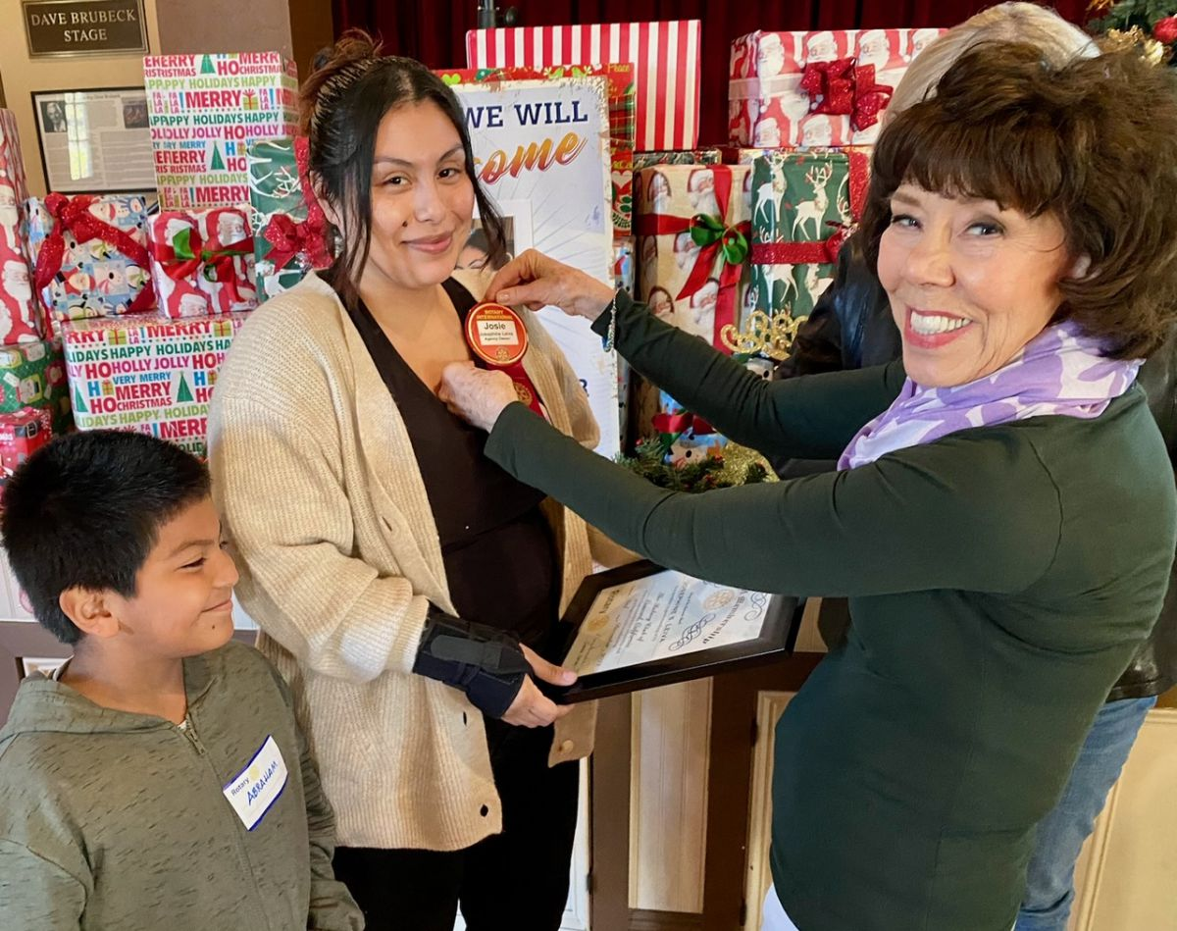
Make New Members Feel Welcome

Slide 5
subhead
ONBOARDING IS A PROCESS

Slide 6
Orientation
Onboarding
One-time event
Role in Rotary
Classroom style
Big picture
Ready to join the club
Ongoing
Role in club
"On-the-job"
Specific to the member
Ready to contribute
Notes:
Discuss the difference between the two.

Slide 7
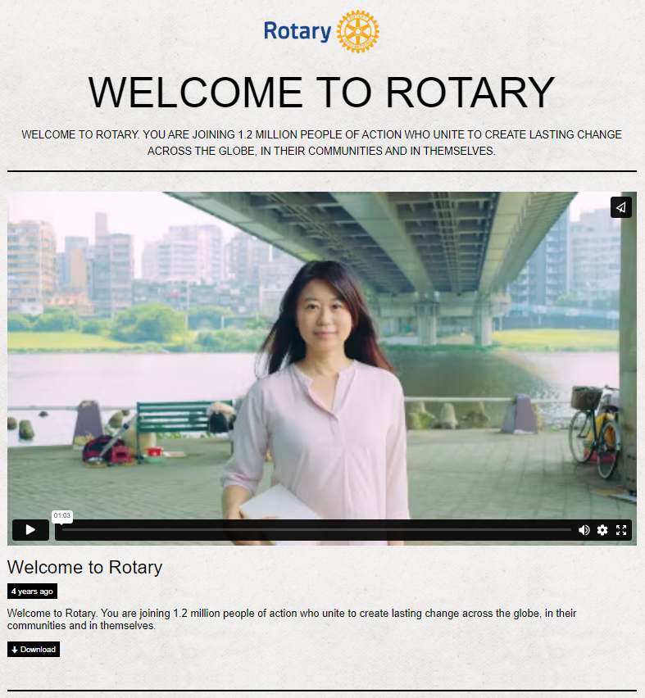
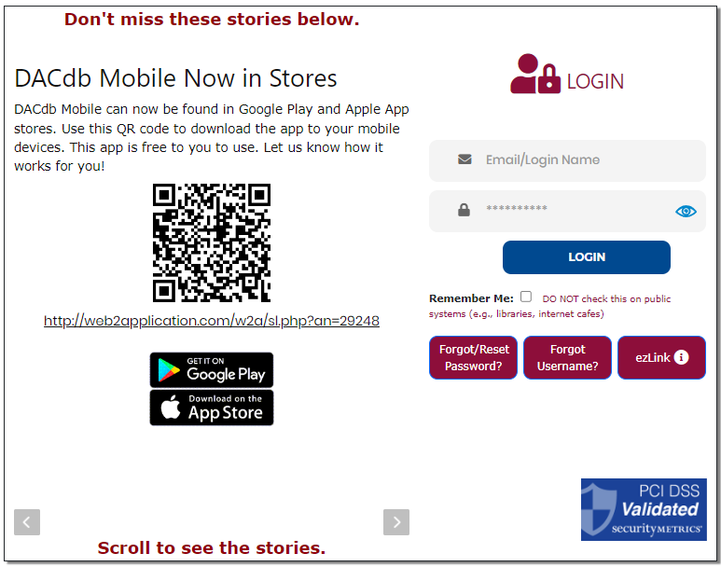
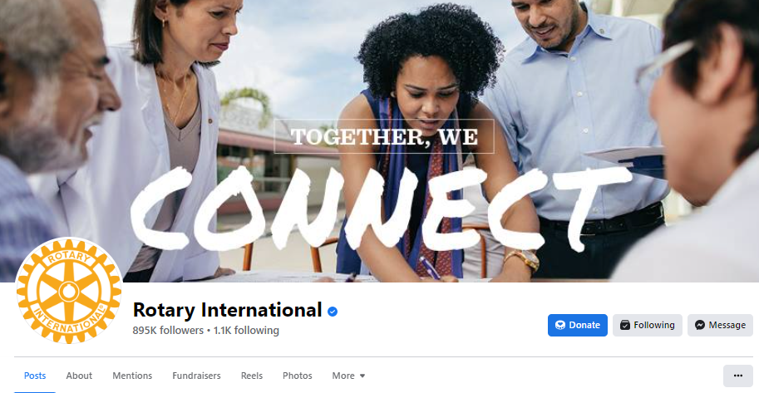
Onboarding ideas
Notes:
Onboarding Activity "Drip" System Ideas:
Send Welcome Video and Ask them to Create a My Rotary Account
Take the Rotary Basics Course in the Learning Center
Ask Them to Like Club, District, and International Social Pages
Send "Open Jobs" with Descriptions
Mentor Check-in
Discuss Experiences
Ask for Their Feedback & Questions
Discuss "Open Jobs" - Check for Interest
Send a List of Other Suggested Learning Center Courses
New Member Dinner
Invite New and Veteran Members to a Dinner
Ask for Their Feedback, Recommendations, and Answer Questions
Leadership/Mentor/New Member Coffee Check-in
Ask for Their Feedback, Recommendations, and Answer Questions
Check to See if They Feel "Plugged In"

Slide 8
“Person” Events
Email Drip Events
Value Alignment Interview
Induction
7 Days: Welcome Video and ClubRunner or DacDB
2 Weeks: Like Social Media Accounts
6 Weeks: Email Regarding Open Jobs (link to club’s website)
4 Weeks: Mentor Check-in
3 Months: Mentor Check-in
4 Months: Email Learning Course Suggestions
6 Months: New Member Dinner
8 Months: Mentor Check-in
3 Weeks: Take Rotary Basics Course & My Rotary Account
12 Months: Anniversary Celebration
Notes:
Example of a dynamic onboarding process utilizing technology to augment member duties.
Now, let’s look at a simplified example.

Slide 9
“Person” Events
Value Alignment Interview
Induction
4 Weeks: Mentor Check-in
3 Months: Mentor Check-in
6 Months: New Member Dinner
8 Months: Mentor Check-in
12 Months: Anniversary Celebration
Notes:
Example of a simplified process without an email drip campaign. This puts the responsibility of someone else helping the member find the resources that could be automate to some degree.

Slide 10
Onboarding GOALS
ORIENTATION
DISCOVER NEEDS
GET CONNECTED
MENTOR
FRIENDSHIP
Notes:
In the end…a good process should make possible these things

Slide 11
Onboarding: Tools
Notes:
Introducing New Members to Rotary: An Orientation Guide
Connect for Good
Rotary Basics
Kick-Start Your New Member Orientation

Slide 12
Getting ALL Members Involved
Worthwhile meetings
Notes:
1. Motivational speeches; 2. Community updates; 3. local speakers; 4. learn something together; 5. examine club bylaws

Slide 13
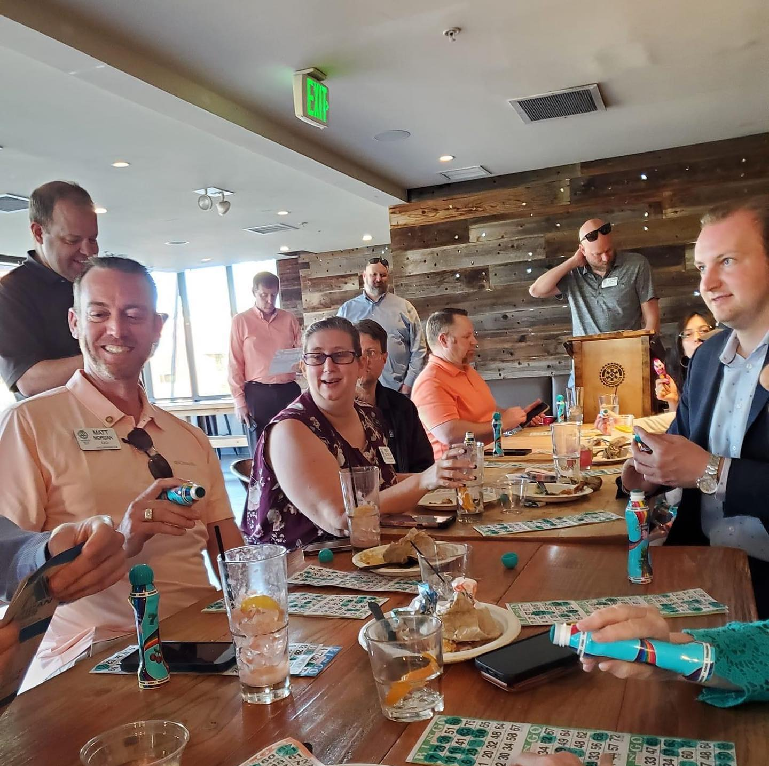
Getting ALL Members Involved
Worthwhile meetings
activities that appeal to differing interests (interactive)

Slide 14
Think, PaThibkThiir, Share
Think, Pair, Share
Notes:
Think, pair, share: Set a problem or a question around a certain topic, and pair up your members. Give each pair of members enough time so they can reach a proper conclusion, and permit them to share their conclusion. Ex. Should we require transfer members to go through our red to blue badge process? Should we consider other types of membership, like corporate, family, etc.?

Slide 15
Jigsaw Activity
Notes:
Jigsaw is a method that focuses on fostering cooperation rather than competition. In this technique, members are divided into teams or “expert groups,” which are each assigned a topic or part of a document or lesson. Each group must select a recorder, time keeper and reporter. Members first learn or discuss their topic and then assemble into jigsaw groups to teach others. Instead of jigsaw groups, they might report their information/findings to the greater group.

Slide 16
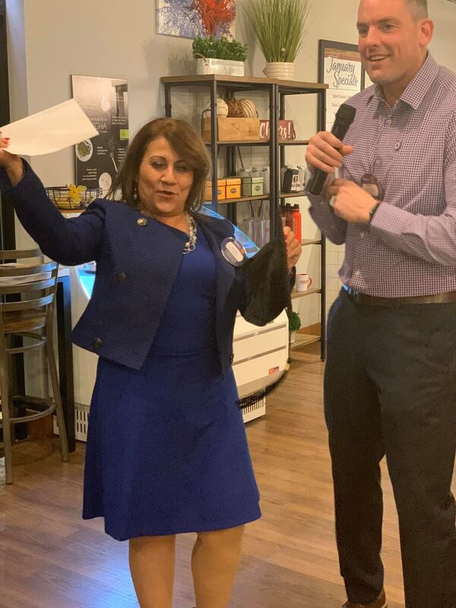
Getting ALL Members Involved
Worthwhile meetings
activities that appeal to differing interests (interactive)
lively and interesting

Slide 17
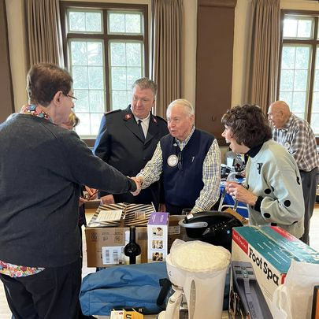
Getting ALL Members Involved
Worthwhile meetings
activities that appeal to differing interests (interactive)
lively and interesting
Have Fun!

Slide 18
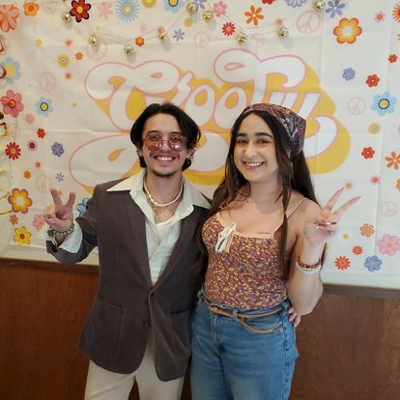
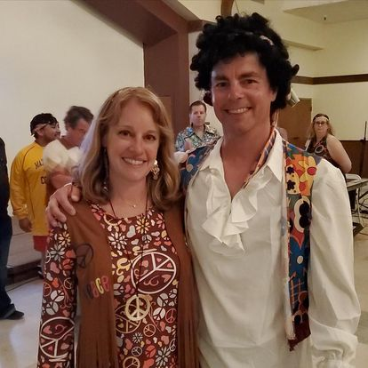
More Fun!

Slide 19
More Fun!

Slide 20
Getting ALL Members Involved
Worthwhile meetings
activities that appeal to differing interests (interactive)
lively and interesting
Have Fun!
Review your meeting format(s), frequency, location, etc.

Slide 21
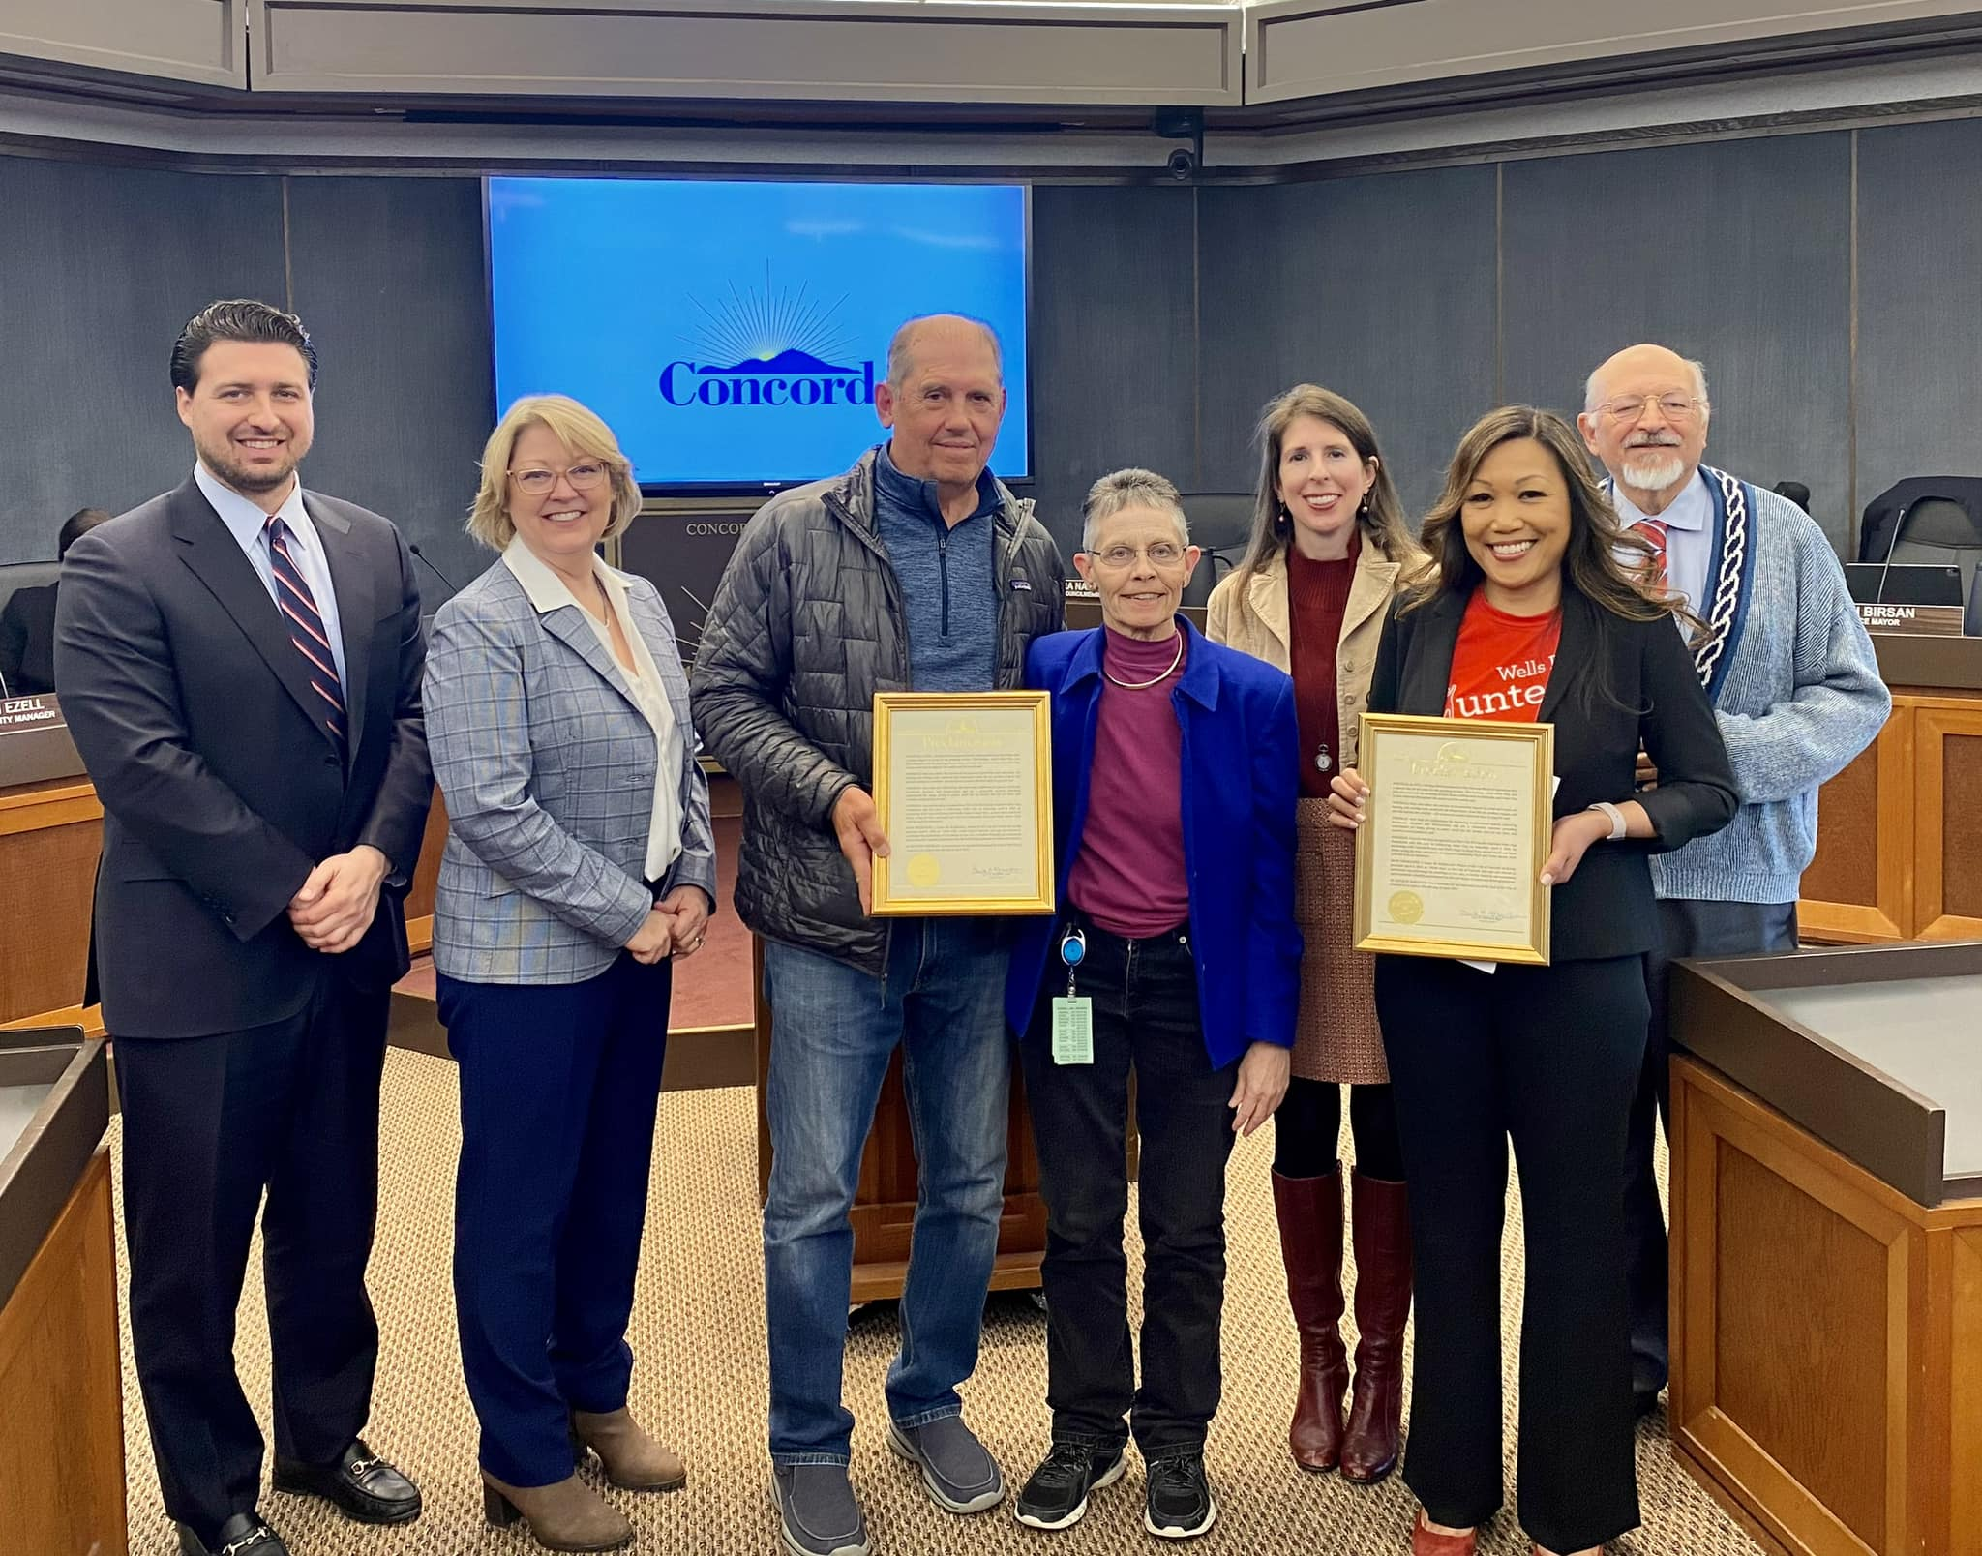
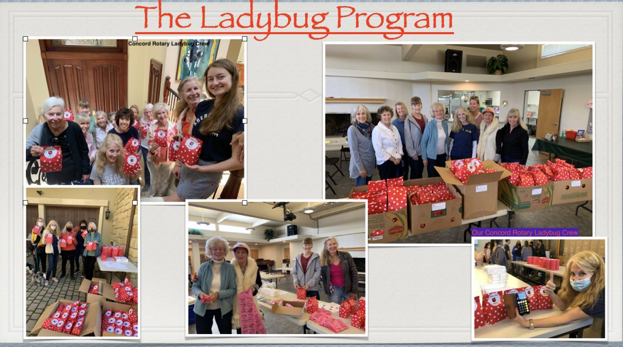
Recognize Members

Slide 22
Inspire Action to Make an Impact
Notes:
Focus on projects that meet real needs b. Assess members’ skills (use their skills in a meaningful way & help others learn) c. Build partnerships (collaborate with other clubs & work with local companies or nonprofits) d. Set service goals e. Measure outcomes

Slide 23
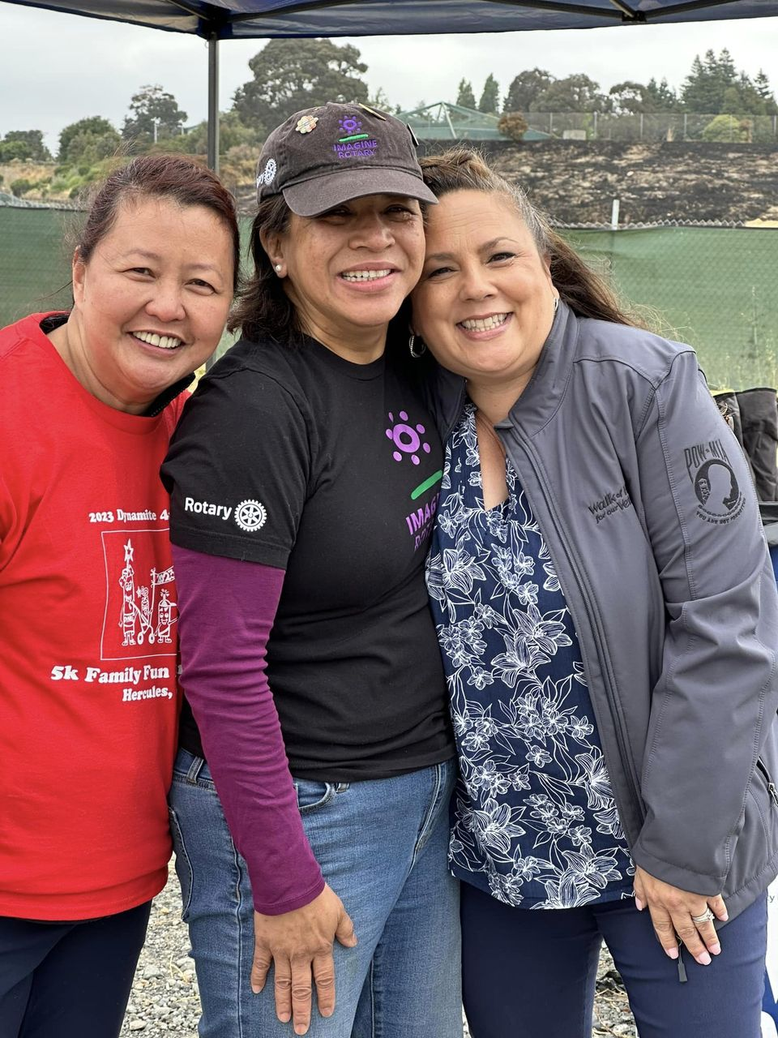
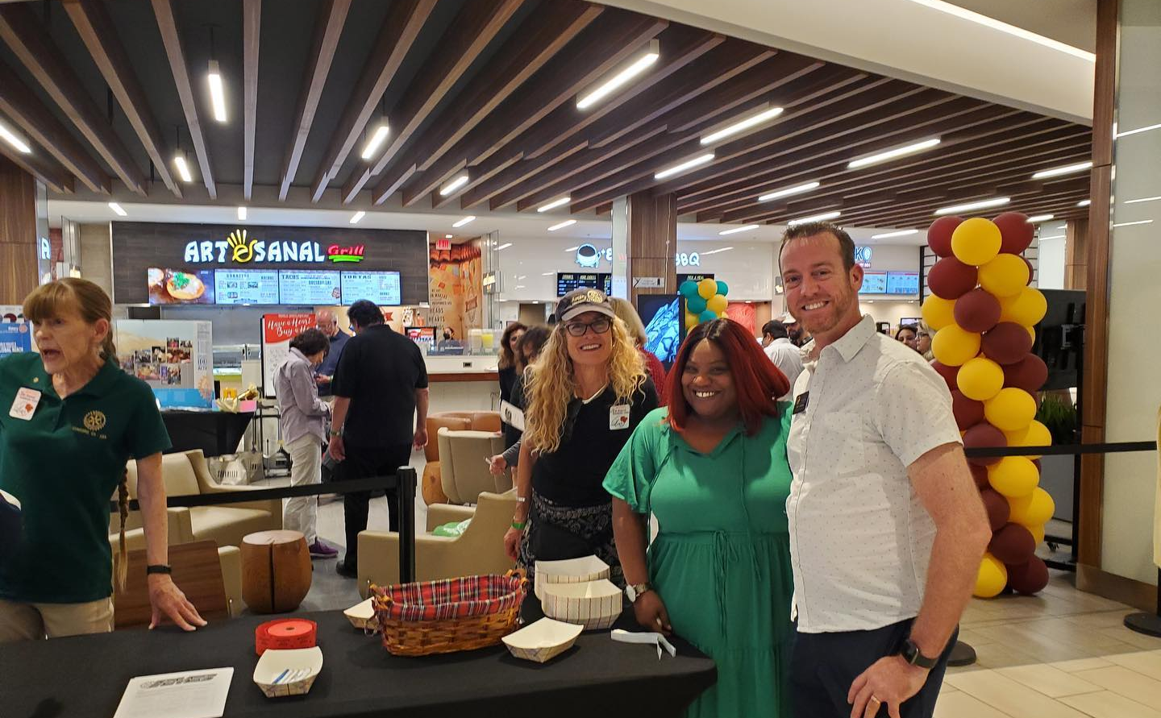
Build Personal Connections
Notes:
1. Extend the meetings; 2. build networking in; 3. plan social events; 4. review who is missing. . .

Slide 24
Implement More Creative Options
Notes:
1. Explore new models; 2. change the club rules (ex. Attendance); 3. offer alternative membership types; 4. offer new clubs

Slide 25
Activity (Jigsaw) Instructions
Get
Get into 5 groups
Assign
Assign a group recorder
Assign
Assign a group reporter
Assign
Assign a group time keeper

Slide 27
Question 1
How can clubs engage members in different ways?

Slide 28
Question 2
What tools can tell us whether our members are happy with their current membership experience?

Slide 29
Question 3
How can clubs make members feel valued for their skills, expertise and efforts?

Slide 30
Question 4
How can clubs be more flexible to accommodate members’ needs and expectations?

Slide 31
Question 5
What are best practices for clubs when making changes?

Slide 32
Groups Report Out
How can clubs engage members in different ways?
What tools can tell us whether our members are happy with their current membership experience?
How can clubs make members feel valued for their skills, expertise and efforts?
How can clubs be more flexible to accommodate members’ needs and expectations?
What are best practices for clubs when making changes?

Slide 33
Questions?
How can clubs engage members in different ways?
What tools can tell us whether our members are happy with their current membership experience?
How can clubs make members feel valued for their skills, expertise and efforts?
How can clubs be more flexible to accommodate members’ needs and expectations?
What are best practices for clubs when making changes?
??

