Slide 1
Club Structure: Flexibility and Innovation

Slide 2
Rotary Club of LaSalle-Centennial
Location
Format
List / Contact
Notes:
Chartered in 2005: 30 members (LaSalle population: 76,000)
By 2019: 9 members
2 hour dinner meeting at a children’s restaurant
What to do:
Moved meeting to golf & country club (attractive to professionals, free)
Changed meeting format to cocktails/appetizers; 1 hour (cost effective; younger members could get home for dinner)
Added variety to meetings
Vocational
Rotary information session
Guest speaker
Club assembly: updated on projects & fundraising
Asked members to make a list of potential members; phone each one, invite to a club meeting
Resulted in 11 new members, 90% were under 40
Remember to have FUN at each meeting
Today: 26 members

Slide 3
DIVERSITY
EQUITY
INCLUSION
Rotary welcomes people of all backgrounds, cultures, experiences, and identities.
Rotary strives for the fair treatment, opportunity, and advancement of all Rotary participants.
Rotary is working to create experiences where all people feel welcomed, respected, and valued.

Slide 4
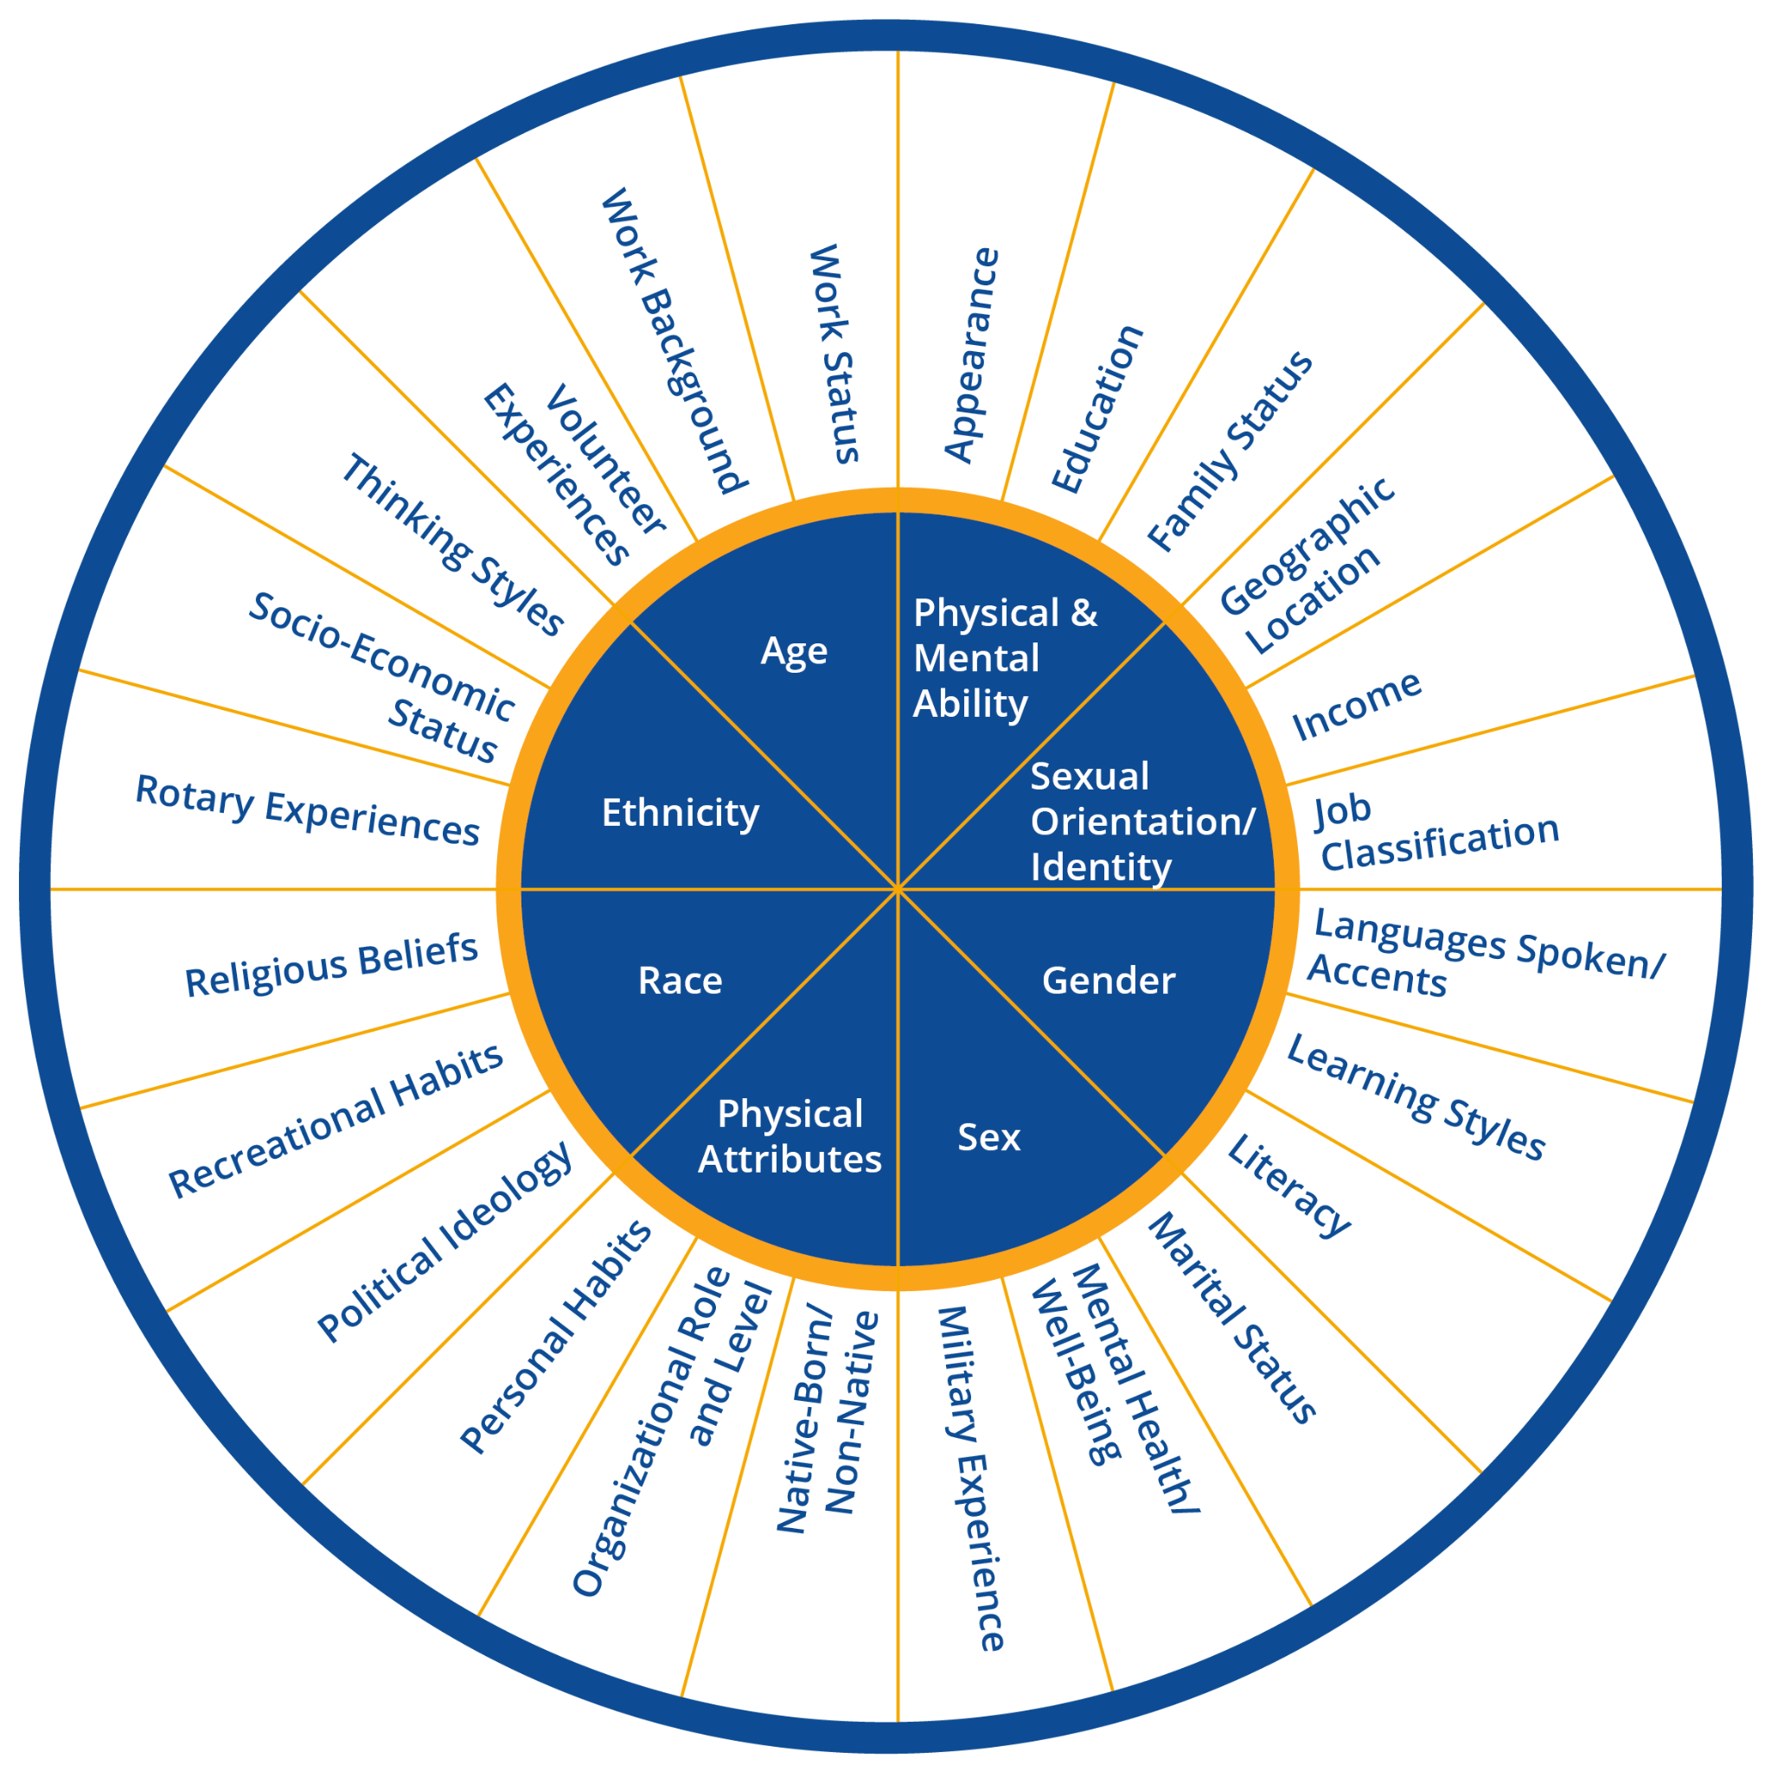
Dimensions of Diversity
Notes:
When we are thinking about creative club structures and creating diverse, equitable, and inclusive clubs we need to keep all of these dimensions of diversity in mind.
I know a member who was a single, childless, nonprofit professional, earning what would be considered a very low salary for the Bay Area when she joined Rotary.
Now Ishe ismarried, has two kids, and am slightly more comfortable in her income.
Luckily, her club has met her needs in both stages.
Think about your club, do you meet the needs of club members who have different dimensions of diversity, or do you only fill the niche for some?

Slide 5
Club Types

Slide 6
TRADITIONAL
SATELLITE
E-CLUB
PASSPORT
CORPORATE
CAUSE-BASED
Professionals and aspiring leaders who meet regularly for service, connections, and personal growth
A Rotary club sponsored by a traditional club but with its own meetings, projects, bylaws, and board
A Rotary club that meets primarily online
A Rotary club that allows members to attend other Rotary club meetings as long as they attend a specified number of
meetings in their own club each year
A club whose members (or most of them) work for the same
employer
A club whose members are passionate about a particular cause and focus their service efforts in that area
And, more …
Notes:
Alumni based -a majority of members (or a majority of charter members) are former Rotary program participants, or former Rotaractors or Rotarians
Interest-based- focuses on a particular interest or hobby
Service-based- meets 2x/month to do service projects; occasionally for socials or fundraiser (don’t want or can’t attend meetings/looking for lower dues)

Slide 7
Membership Types

Slide 8
Partner/Family
Young Professional
Senior/Retired
Service-Focused
Introductory Membership
Friends of Rotary
Corporate
And, more …
Notes:
Membership types typically have different financial and time commitments to the club.
Partner/Family
A Partner/Family Membership consists of any family member of an Active Member (e.g. spouse, partner, adult aged child). family members are all active members and have all the same rights, privileges and obligations as other club members, though financial obligations are somewhat reduced in order for a family to financially support more than one member.
Young Professional
This category is for those 35 years and under who demonstrate leadership in their profession and meet all the qualifications of Rotary membership. Young Professionals typically pay reduced fees for their first five years of membership. Given that potential Rotarians in this category may have less flexibility in taking time away from their jobs, attendance modifications could also be considered.
Senior/Retired
Retirement means a reduced family income, but more time to volunteer and serve the community. We’ve had some members that have benefitted from their employers covering Rotary costs, that than leave the Club upon retirement because of the financial commitment. This membership category could alleviate this challenge.
Service-Focused
This category is for potential members that have a strong interest in volunteering and doing good works, but limited time for and/or interest in attending meetings. Finances are not the constraint for these types of people.
Introductory Membership
This is for individuals that may shy away from joining Rotary given the upfront costs, yet once they enjoy the Rotary experience, the cost is worth it (or so the theory goes). Typically, new members joining under this category pay 25% of dues for the first six months, and 50% of dues for the second. After the first year, they would be treated as a full Active Member.
Policy decisions to consider:
Friends of Rotary
For this category, some Clubs use the designation of “Associate Member.” This category is a way to allow individuals to “test the waters” for a prospective new member. In these cases, though, Friends or Associates only pay for meals, no dues, and therefore do not count as “Rotarians.”
Corporate
The interest with this category is multi-fold: Re-connect the top leaders of major corporations and large employers with Rotary, while recognizing the time constraints of these individuals. It allows the CEO or major department managers to be the “Designated Active Member” of Rotary for the company, yet they can designate one or two others in the Company to attend meetings and meet day-to-day obligations of being a Rotarian on their behalf.

Slide 9
What membership types does your club currently offer?

Slide 10
True Cost of Membership

Slide 11
Dues (International, District, Club)
Meetings/Food
Required (?) Donations
Required Events
And…
Notes:
What is your club’s true cost of membership?
A local club near you is $500
Break it down:
$260 to RI
What else do you expect?

Slide 12
Meetings

Slide 13
Flexibility is what it is all about…
LOCATION
DATES/TIMES
TOPICS
MEALS
Hybrid
Off-site Field Trips
Restaurant
Community Center
Homes
# of times per Month
Time of Day
Rotating
Speakers
Crafts
Service Projects
Fellowship
Family Nights
Field Trips
Hikes/Walks
And, more …

Slide 14
Where does your club currently meet? What time? What types of topics?

Slide 15
So, what can your club change?

Slide 16
Thanks!

Slide 17
Credits
Heather Vilhauer
Dougherty Valley/San Ramon Rotary Club
heatherv@rotary5160.org
This is where you give credit to the ones who are part of this project.
Did you like the resources on this template? Get them for free at our other websites.
Presentation template by Slidesgo
Icons by Flaticon
Images & infographics by Freepik
Photos created by Freepik - Freepik.com

