Slide 1
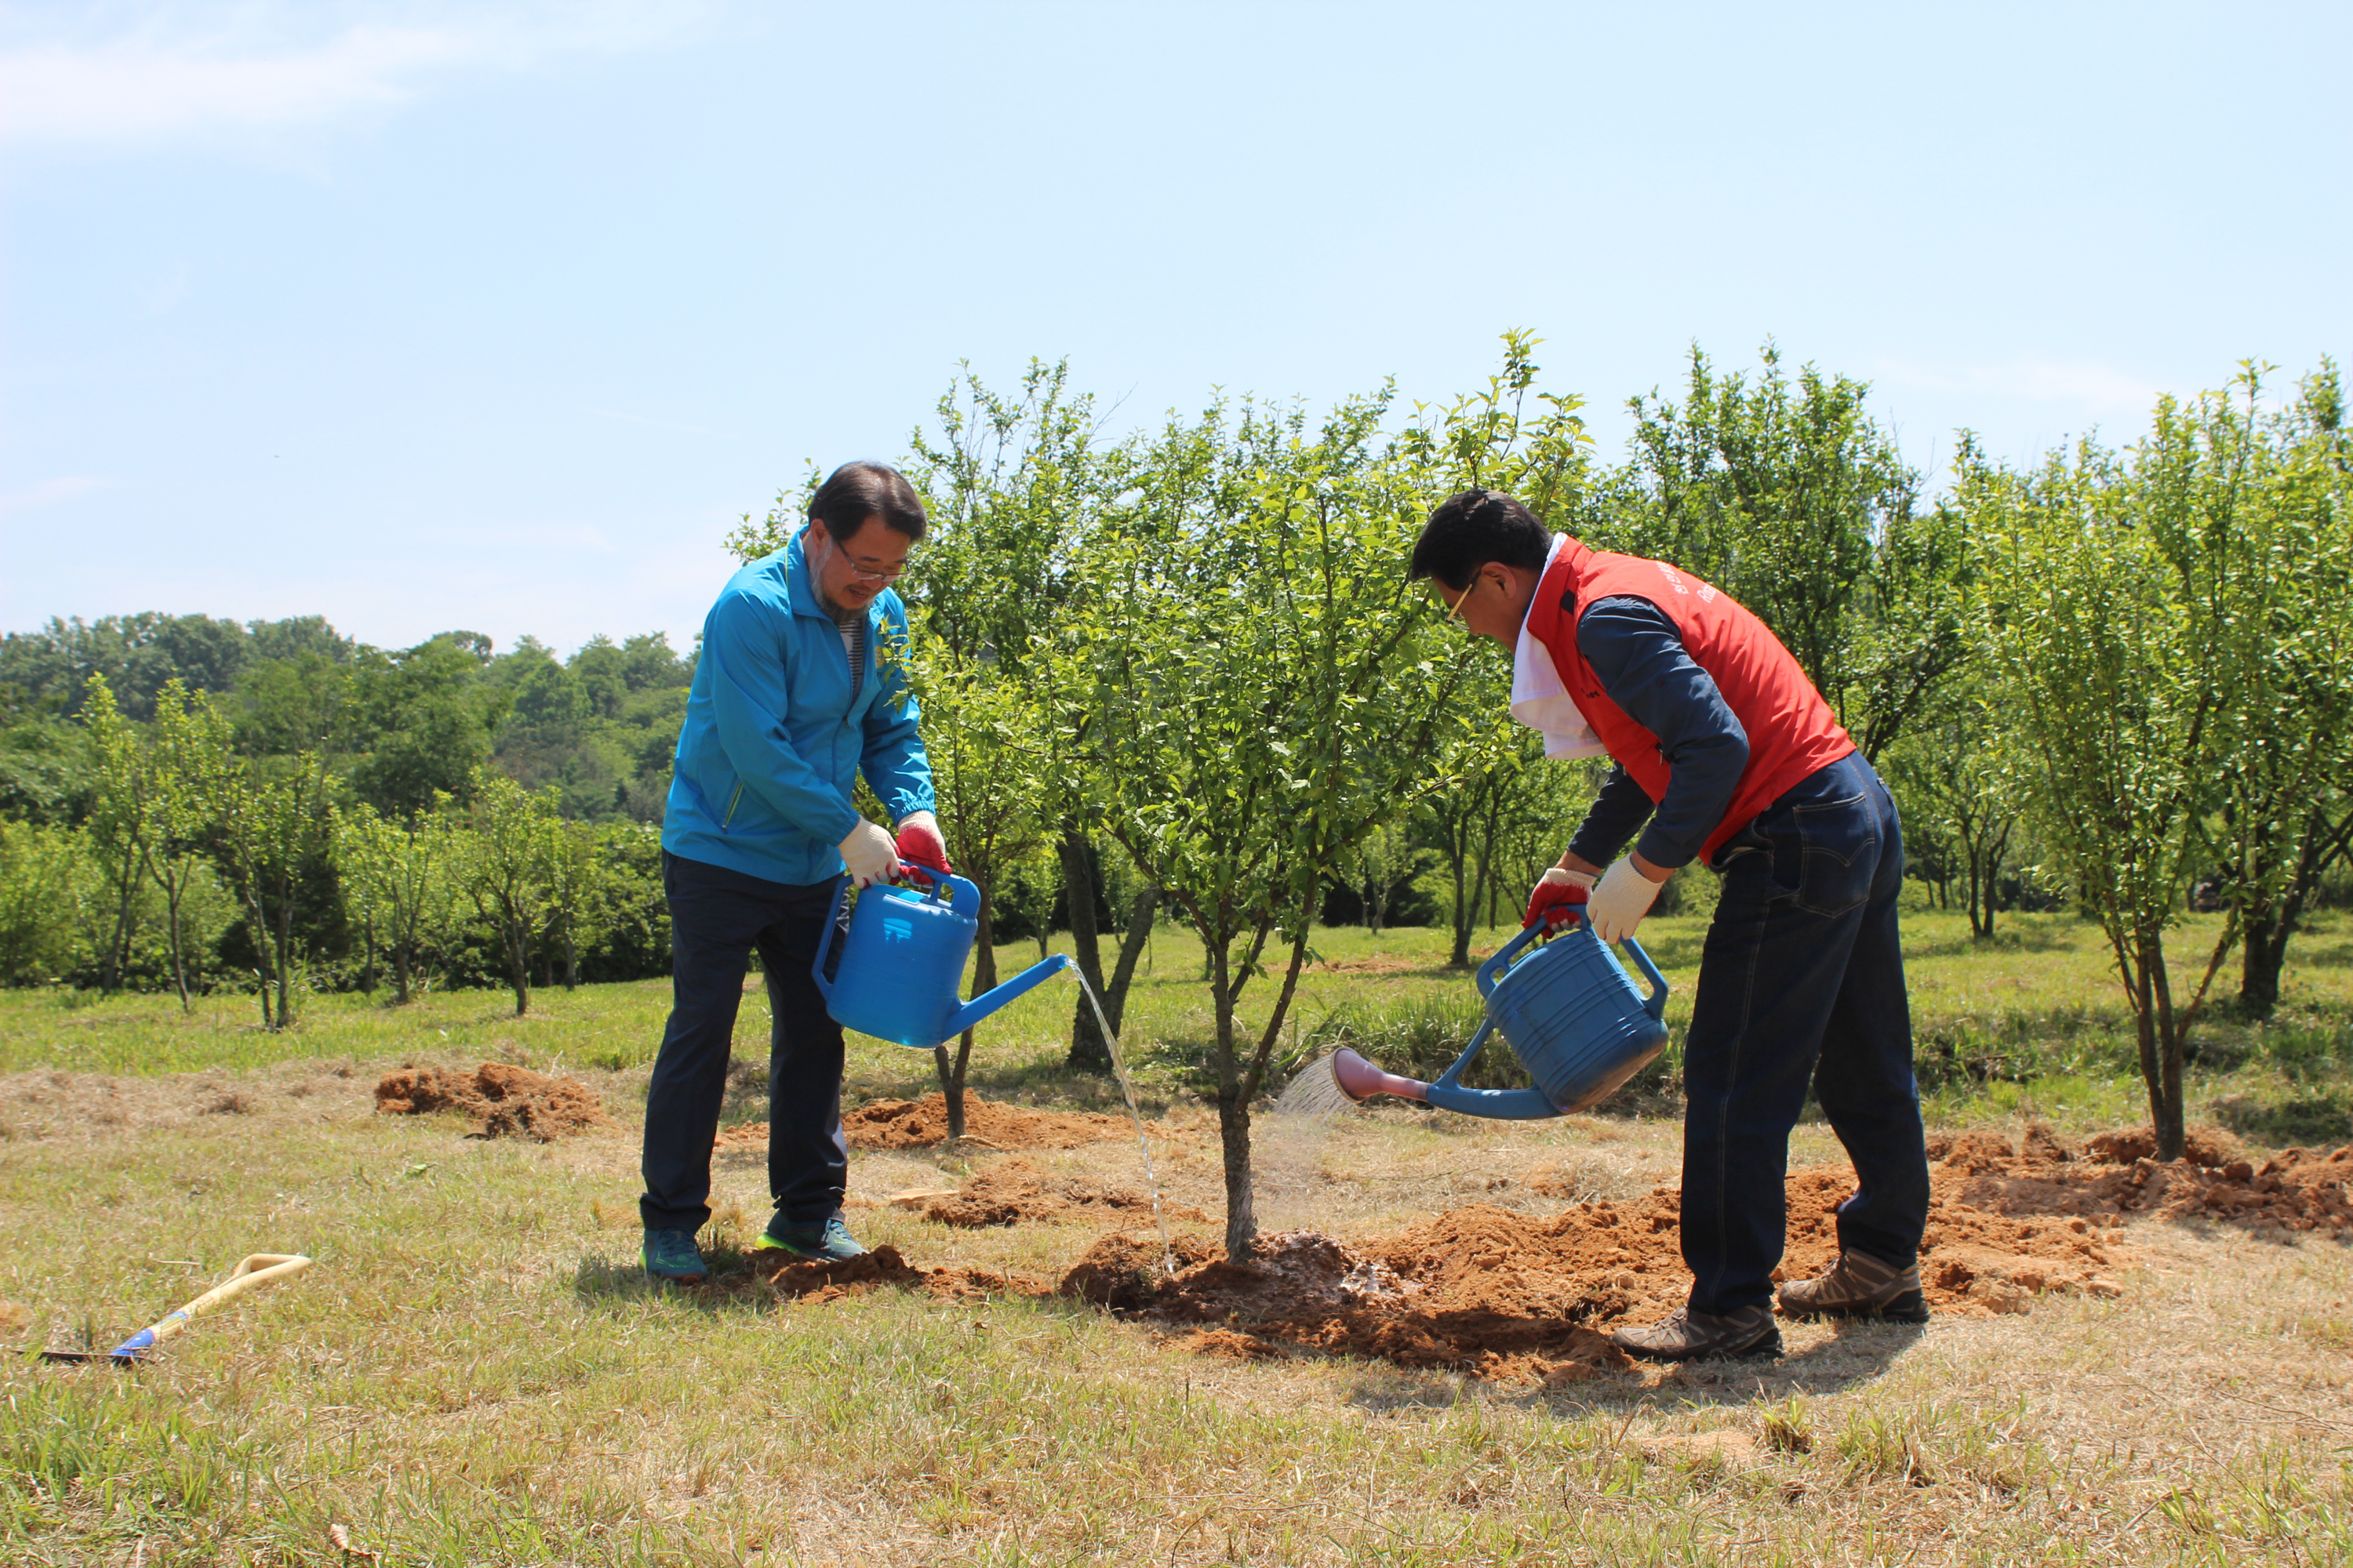

Onboard New Members

Slide 2
Three phases
Value Alignment
Induction
Onboarding

Slide 3
subhead
The Value Alignment Interview
Notes:
Taking the time to discern what is motivating this prospective member. What are they looking for, and are we a good fit.
Determining what their specific interests are so we can channel them in that direction quickly.
Managing expectations on the front end.

Slide 4

Tell me a little bit about yourself personally and professionally.
How did you find Rotary?
What is appealing about it?
Sample Value Alignment Questions
Title Page Option
Notes:
Once you’ve both agreed that this is a good fit, design a celebratory Induction Ceremony.
Be organized, make it special, make them feel welcome.

Slide 5
What are your expectations? What else? What else?
If we ended up deciding this was the right fit, and it’s one year from now, how would you describe your experience in more detail?
How do you think you would contribute to the club’s success?
Sample Value Alignment Questions
Title Page Option
Notes:
Once you’ve both agreed that this is a good fit, design a celebratory Induction Ceremony.
Be organized, make it special, make them feel welcome.

Slide 6
Manage Expectations:
  Is this what they really want?
  Money
  Time
  Talent
  If not us, then who?
Sample Value Alignment Questions
Title Page Option
Notes:
Once you’ve both agreed that this is a good fit, design a celebratory Induction Ceremony.
Be organized, make it special, make them feel welcome.

Slide 7
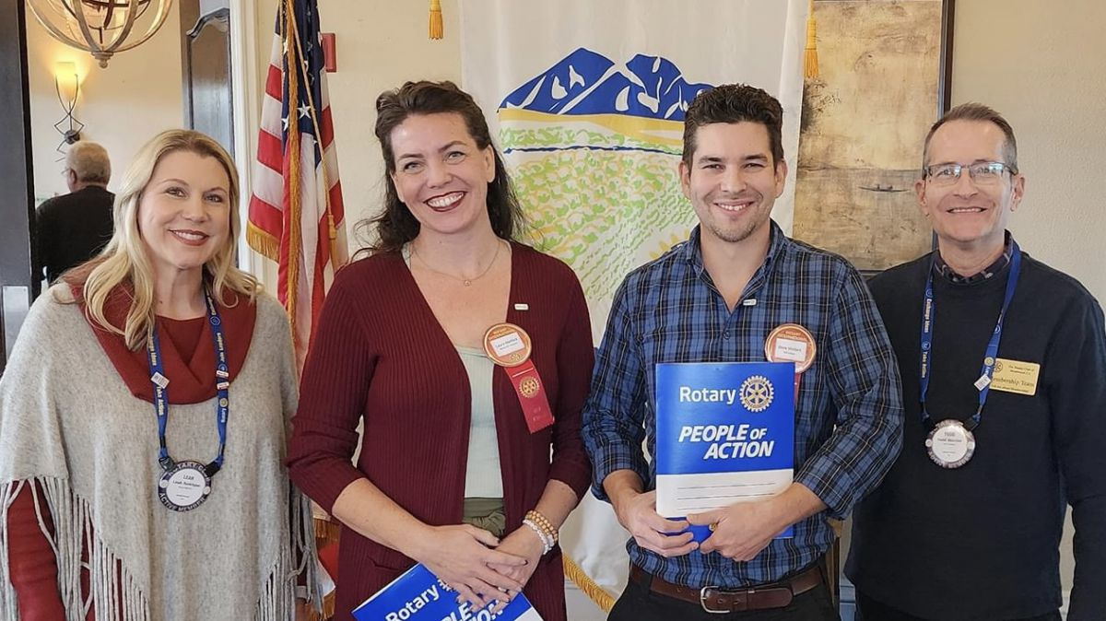
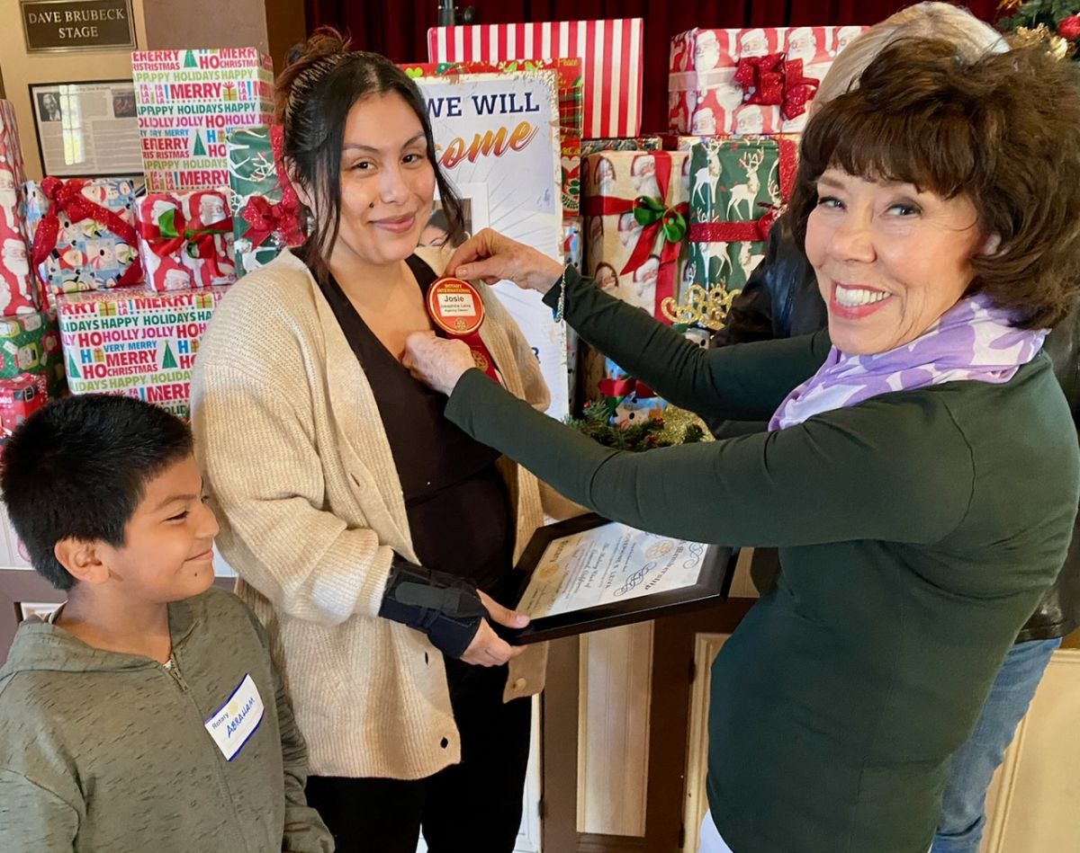
Induction
Notes:
Introduce the new member to the club.
Ensure the new member understands the privileges and obligations involved in becoming a Rotarian
Celebrate the new member: newest member in the World!

Slide 8
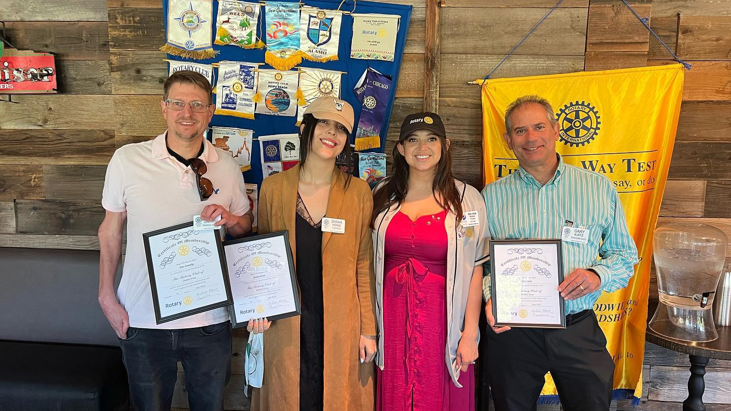
Make New Members Feel Welcome

Slide 9
subhead
The Onboarding Process
Notes:
After the induction, let’s put together a plan to integrate the new member effectively into the club.

Slide 10


THE “STICKINESS” FACTOR
Feel of Value
Have a Friend
Notes:
We know that year one is critical. If we can facilitate the rapid development of the new member feeling they are of value to the club (they have a role that is meaningful and in alignment with their interests), and they find a friend, they’re more like to stay – i.e. – the “Stickiness Factor”

Slide 11
subhead
ONBOARDING IS A PROCESS

Slide 12
Orientation
Onboarding
One-time event
Role in Rotary
Classroom style
Big picture
Ready to join the club
Ongoing
Role in club
"On-the-job"
Specific to the member
Ready to contribute
Notes:
Discuss the difference between the two.

Slide 13
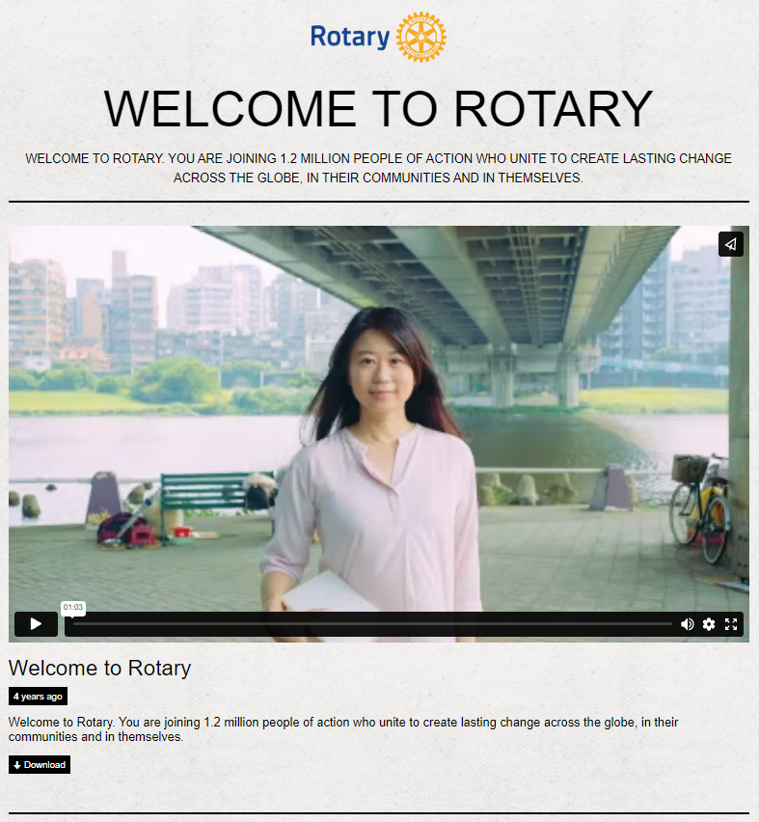
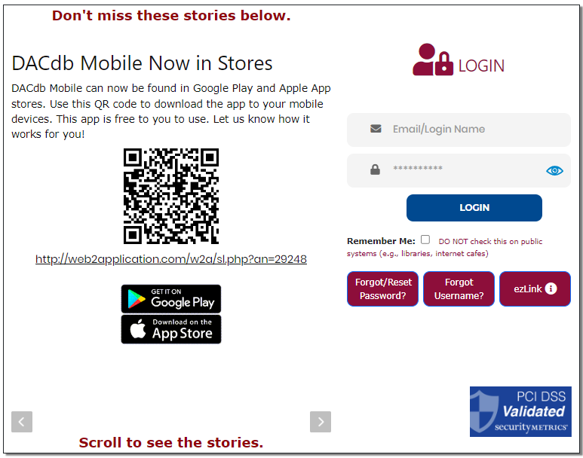



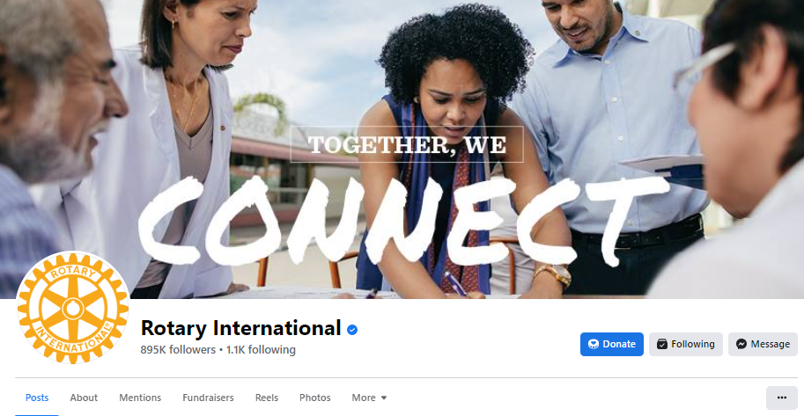
Onboarding ideas
Notes:
Onboarding Activity "Drip" System Ideas:
Send Welcome Video and Ask them to Create a My Rotary Account
Take the Rotary Basics Course in the Learning Center
Ask Them to Like Club, District, and International Social Pages
Send "Open Jobs" with Descriptions
Mentor Check-in
Discuss Experiences
Ask for Their Feedback & Questions
Discuss "Open Jobs" - Check for Interest
Send a List of Other Suggested Learning Center Courses
New Member Dinner
Invite New and Veteran Members to a Dinner
Ask for Their Feedback, Recommendations, and Answer Questions
Leadership/Mentor/New Member Coffee Check-in
Ask for Their Feedback, Recommendations, and Answer Questions
Check to See if They Feel "Plugged In"

Slide 14
“Person” Events
Email Drip Events
Value Alignment Interview
Induction
7 Days: Welcome Video and ClubRunner or DacDB
2 Weeks: Like Social Media Accounts
6 Weeks: Email Regarding Open Jobs (link to club’s website)
4 Weeks: Mentor Check-in
3 Months: Mentor Check-in
4 Months: Email Learning Course Suggestions
6 Months: New Member Dinner
8 Months: Mentor Check-in
3 Weeks: Take Rotary Basics Course & My Rotary Account
12 Months: Anniversary Celebration
Notes:
Example of a dynamic onboarding process utilizing technology to augment member duties.
Now, let’s look at a simplified example.

Slide 15
“Person” Events
Value Alignment Interview
Induction
4 Weeks: Mentor Check-in
3 Months: Mentor Check-in
6 Months: New Member Dinner
8 Months: Mentor Check-in
12 Months: Anniversary Celebration
Notes:
Example of a simplified process without an email drip campaign. This puts the responsibility of someone else helping the member find the resources that could be automate to some degree.

Slide 16





Onboarding GOALS
ORIENTATION
DISCOVER NEEDS
GET CONNECTED
MENTOR
FRIENDSHIP
Notes:
In the end…a good process should make possible these things

Slide 17
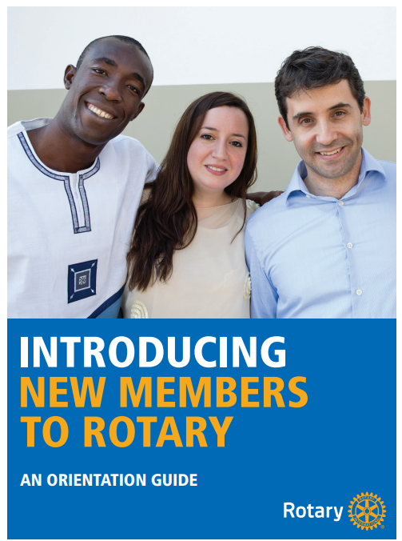


Onboarding: Tools
Notes:
Introducing New Members to Rotary: An Orientation Guide
Connect for Good
Rotary Basics
Kick-Start Your New Member Orientation

Slide 18
Activity (Jigsaw) Instructions
Get
Get into 5 groups
Assign
Assign a group recorder
Assign
Assign a group reporter
Assign
Assign a group time keeper

Slide 19
Group 1
Does your club conduct a Value Alignment Interview (or Fireside Chat)?
What could be done to improve what your club is doing/asking?
How can we engage new members more quickly?

Slide 20
Group 2
Does your club orient your new members or onboard?
What could you change about your new member process to make it more meaningful and last over a longer period of time?

Slide 21
Group 3
What was your personal experience when joining your club (Induction)?
What more could have been done to enhance your experience?

Slide 22
Group 4
What are some innovative onboarding ideas that would enhance member participation?
Where could you find some supporting materials or new ideas?

Slide 23
GROUP 5
What are some best practices that would enable the sustainability of an onboarding process for a club?
How would you recommend changing your club’s onboarding practices?

Slide 24

Breakout Discussion
Onboarding New Members
Title Page Option

Slide 25
subhead
THANK YOU!

Slide 27
What was your personal experience when joining your club? What more could have been done to enhance your experience?
What are some innovative onboarding ideas that would enhance member participation?
What are some best practices that would enable the sustainability of an onboarding process for a club?
onboarding
Discussion Questions

