Slide 1
District Online Grant Application
Rene Duddy
Rotary Club of Vaca Valley Eventide
District Executive Secretary
Grants Manager

Slide 2
DACdb
www.DACdb.com
Login to Dacdb
Notes:
Login to DACdb – if you have never done this and require assistance, contact Tina Akins tina.akinsrotary@gmail.com

Slide 3
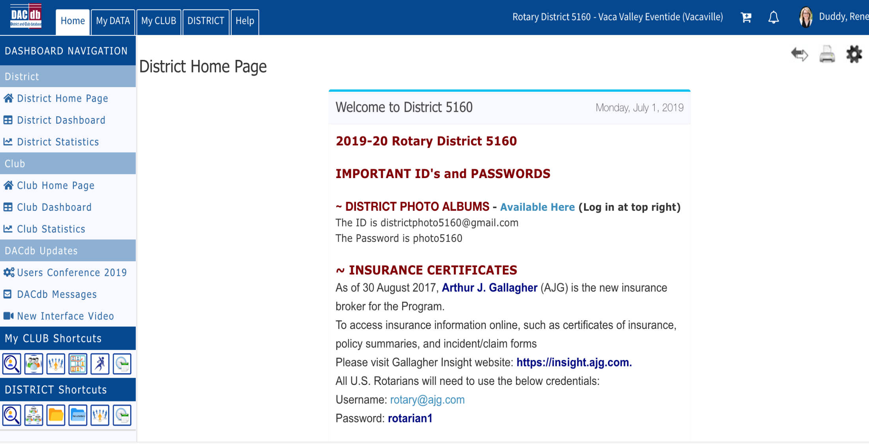
First Step

Slide 4
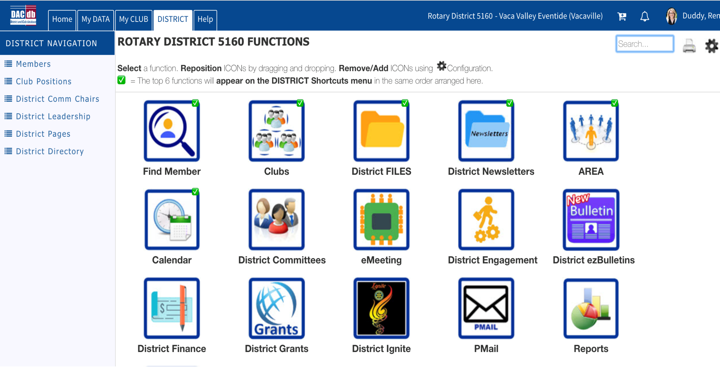

Slide 6
Club Grants
New Club Grant Request-Click Here to Create Grant
Be sure you are in the correct OrgYear when writing your
Grant. For this year it is 2019-20. Click OrgYear, then the current year.
Notes:
You can also click OrgYear and go to any year that you want to see a list of approved grants. Just remember to change the OrgYear back when entering a current grant. You can see the test grant below in the Vaca Valley Eventide Club. When you get to this section, it will be titled with your club and any grants that have previously been written for the year will be listed. Each project will have a name that you give it, so you will know which one to open. Lead Club Name – all clubs involved in the grant will be listed, however the Lead club will have an asterisk. Status – tells you where your application is in the grant process.

Slide 7
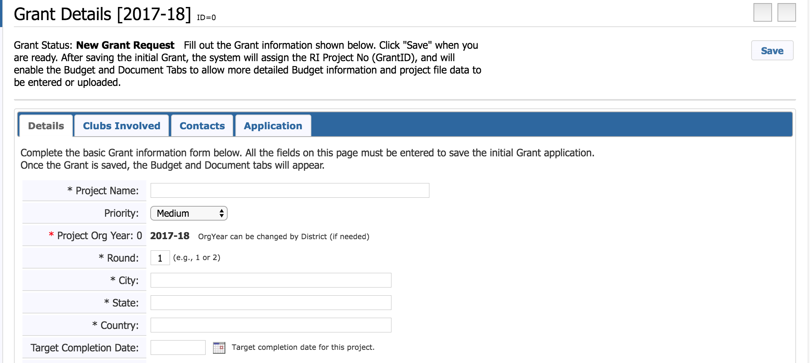
Notes:
The online grant looks very similar to the previous paper version. Just fill in the blanks in each section. You can click the save button in the top right hand corner at any time. Once saved you or another grant writer can go back in to the application and continue working on it.

Slide 8
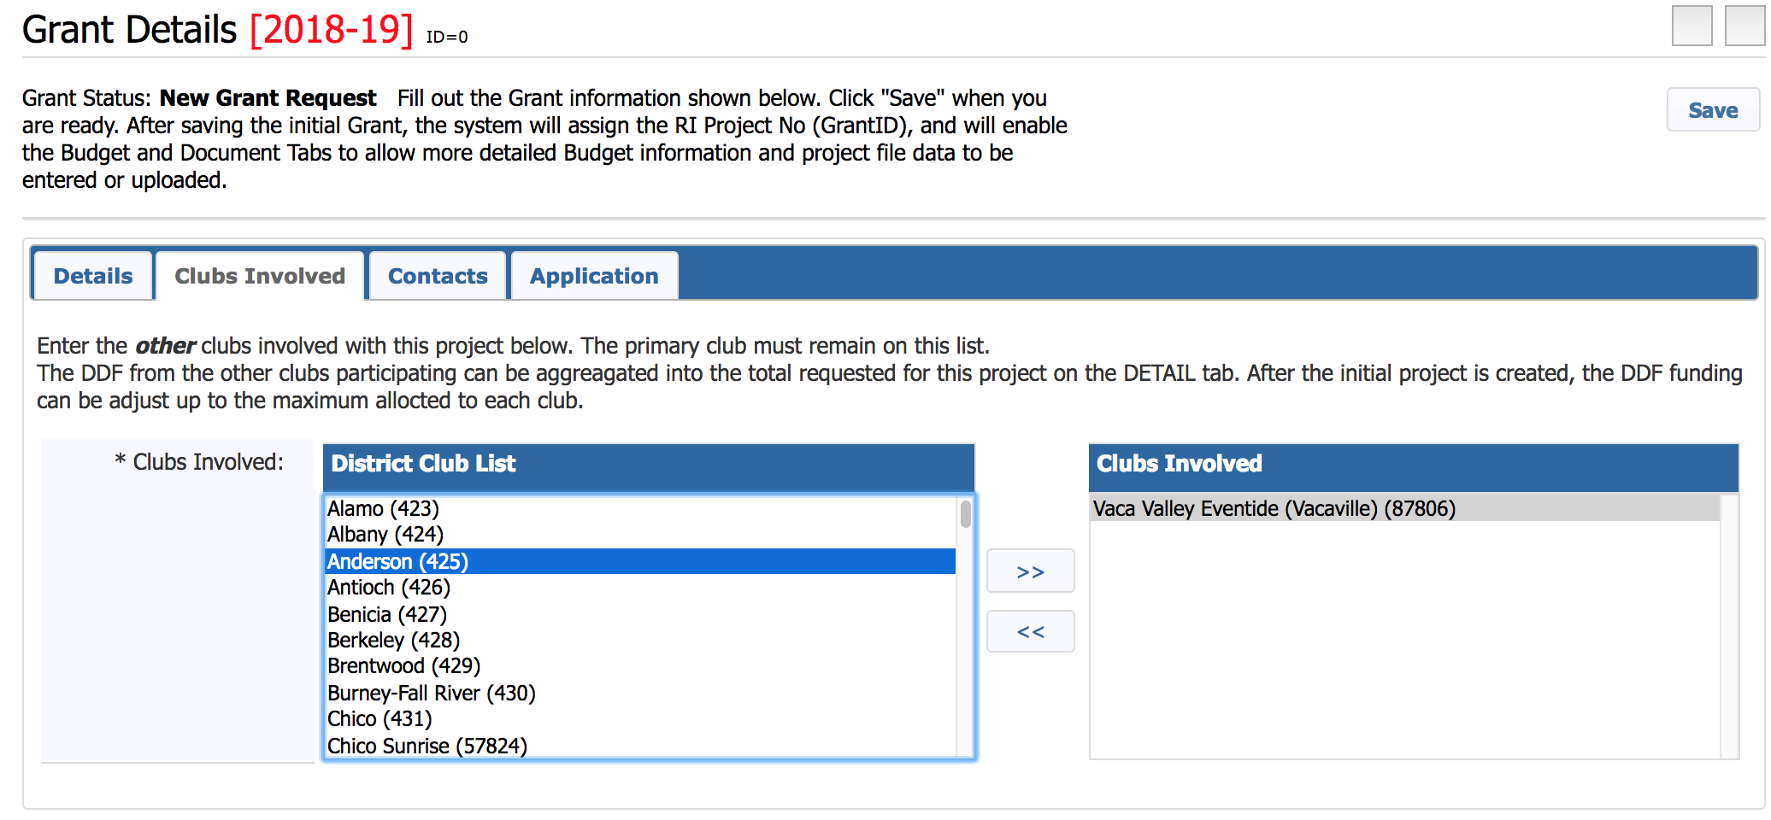
Enter all Clubs Involved in Project
Notes:
Any club that is part of this grant, whether financially or manpower must be listed on this page.

Slide 9
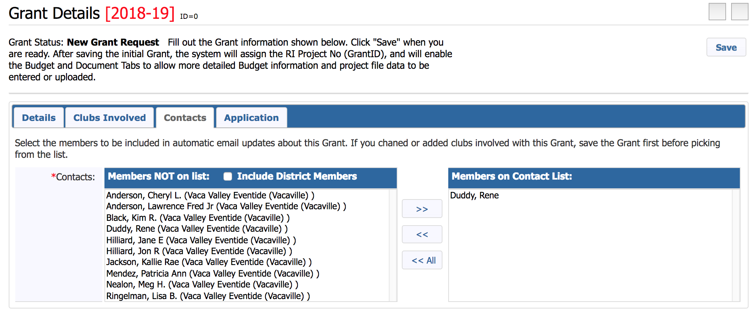
Contacts on Grant
These are the members who will be receiving the emails
Notes:
This is similar to the clubs involved. List the contacts – the members who will be receiving the emails and correspondence regarding this grant.

Slide 10
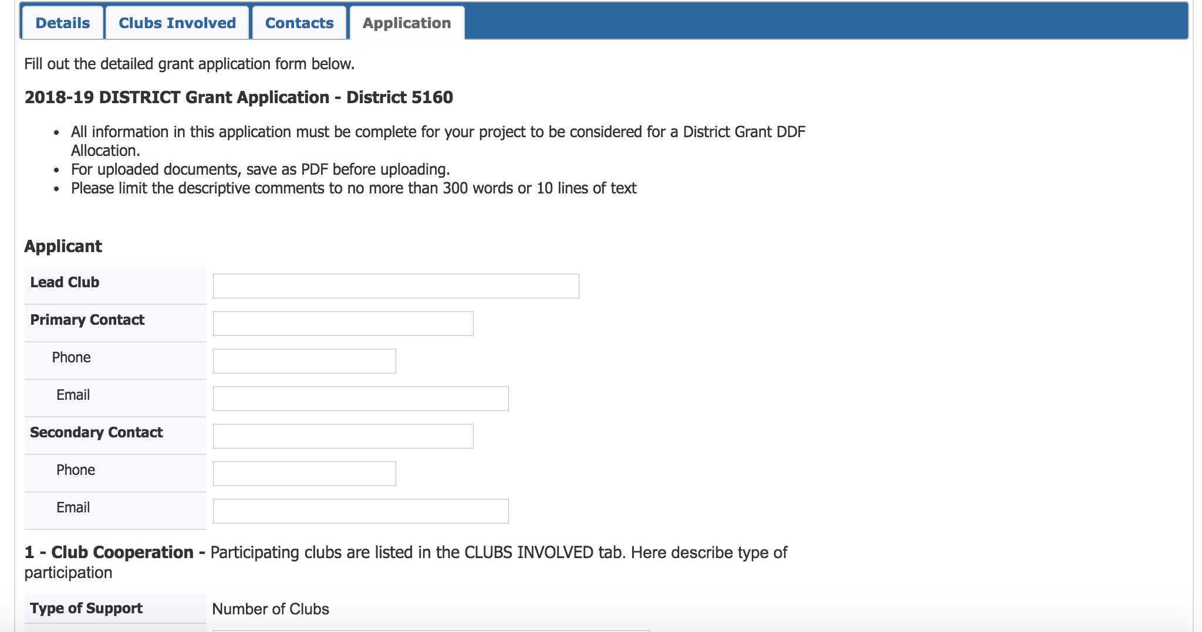
Application – Fill in Boxes
Notes:
This online application follows very similarly to the previous paper one. Just fill in all the boxes with the information requested. * Note: please keep the descriptions short and concise as there is limited space for text. If the grant requires any forms, pictures, or additional information, that can be added later in the Details tab.

Slide 11
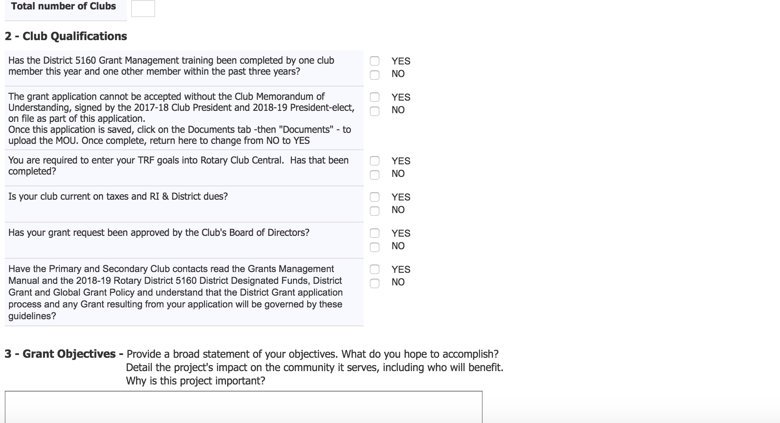
Club Qualifications for Grant Approval
Notes:
These 6 questions are to help you remember what needs to be done before submitting a grant. If these are answered YES but they are not completed the Grant will automatically be rejected.

Slide 12
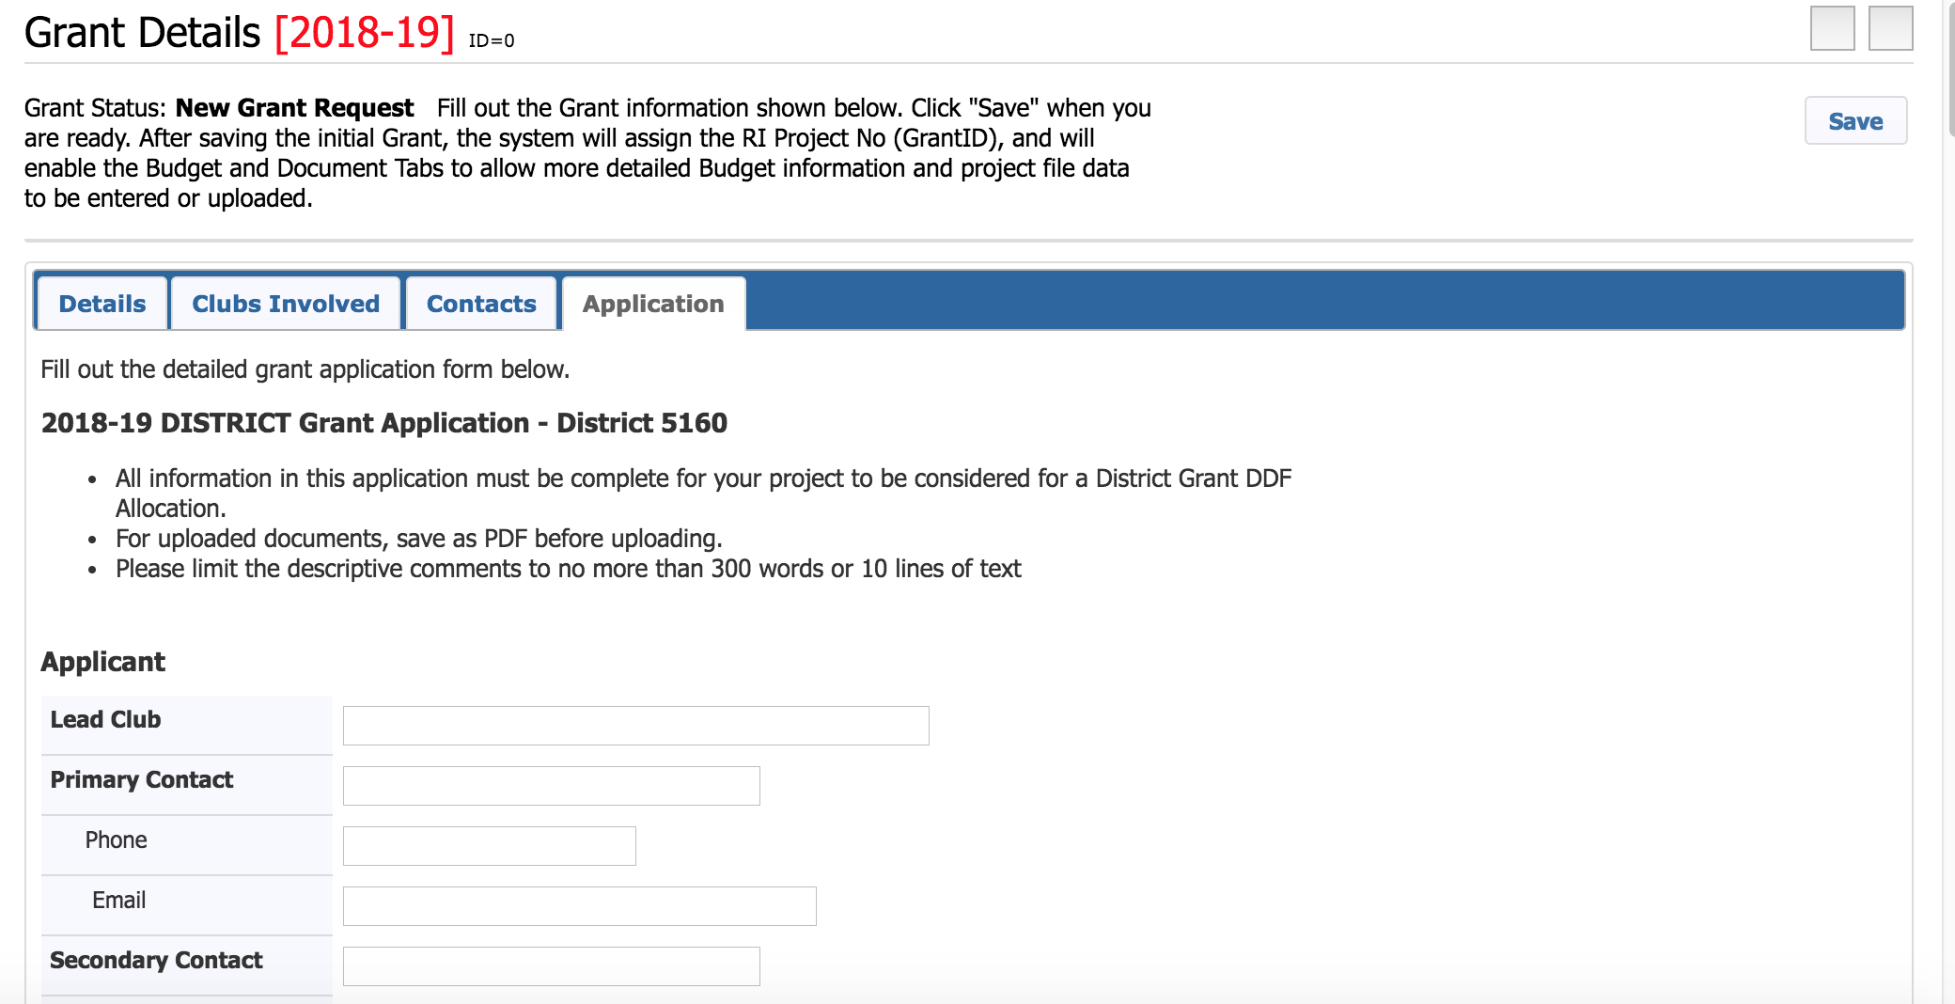
Saving Application
Notes:
Fill in all areas of the Grant Application completely and then click SAVE. You can save your work at anytime and not lose any of your data. Once it is saved, any other club grant writer can go into the module and continue filling in the information. There were many questions on the online webinar about writing the grant in a Word Document and then copy and pasting into this document. The challenge is that this is html, and sometimes when you copy and paste you will have to reformat. In addition, it is double work to do that. You can do whatever is easiest for you, however having this online is quicker and easier than the paper version. Keep in mind that the Grants Review Committee will not be reviewing the Grant until you click on the Submit button, so you can continue to make changes and updates.

Slide 13
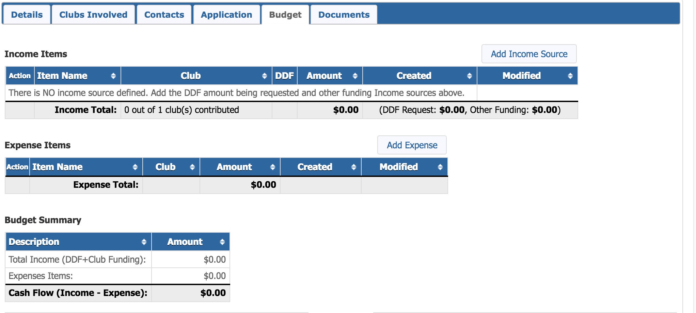
Budget
Notes:
After application has been saved, two more Tabs will appear – Budget and Documents. Under Budget, Under Income you will enter the DDF requested amount as well as all other sources of income, i.e. amounts from each individual club or one lump sum from just your club. Each amount gets entered separately. Reminder Income from other sources must equal .50 for every $1 of requested DDF funds. Under Expense Items, Each individual expense gets listed here. This is just estimated for now. After the Grant is complete, come back in and adjust to exact spent amount.

Slide 14
Documents
Notes:
The Documents tab is where you will upload all invoices, receipts, bank statements, and MOU. In addition, all pictures can be added here, and anything that is a jpeg will automatically populate in the Interim and Final Reports. As you can see, the Application automatically comes up in this section as well.

Slide 15
Club Signatures
Notes:
Once all Budget information has been entered and preliminary documents have been uploaded (MOU), you are now ready to Collect Club Signatures. We require two signatures, so this will be done twice. Click on Club Signatures and an auto-generated email will go to both signees on the grant. It will tell them to go into the Grant and sign it. Signee will go to Grants – Club Grants – open up the Grant Application and Click Sign Grant Application. Both signees are required to do this, and then it is ready to submit. You will also see that after the club signatures have been added, two more tabs – Activity Log and Signatures pop up. The Activity Log shows a timeline of what has occurred with this application each time a change has been made, and who has made the change. The Signatures tab shows who the two signees are and who has acuatally signed the application. This way, if the grant writer is unsure who still needs to sign, they can go here and find out.

Slide 16
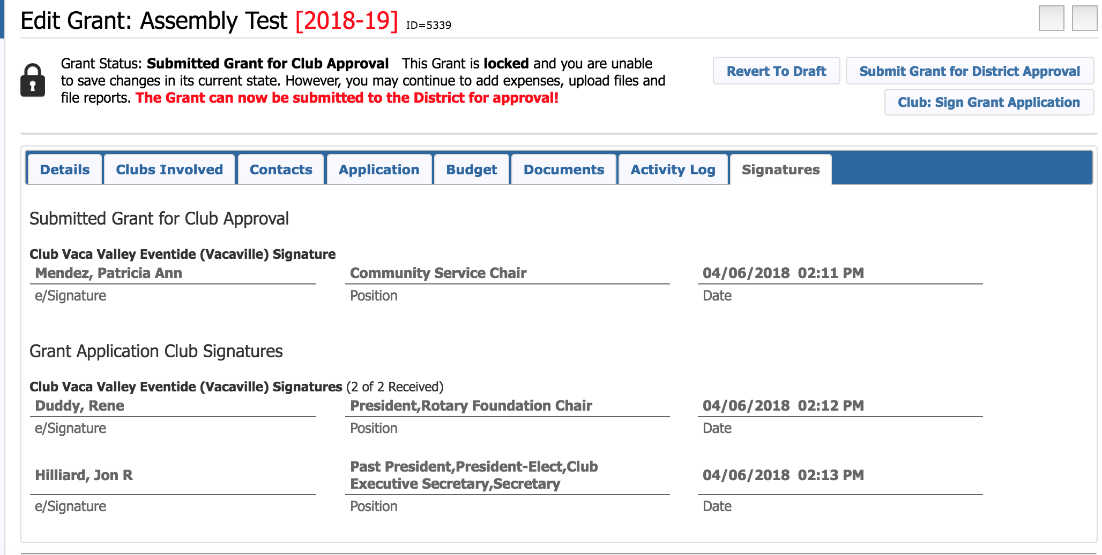
Club Signatures

Slide 17
Interim and Final Reports
Notes:
Once District Approves your Grant, two more Tabs will appear – Interim and Final Reports. This is where you will fill out the reports either midway through or after project is complete. Follow the top tabs to collect signatures once again.

Slide 18
Questions

Slide 19
Support
For questions during the Grant Application process contact:
Rene Duddy
reneduddy@yahoo.com
707-430-1066
OR Walt Schafer
walt5160@yahoo.com

